Slide 1

APP manual
～ Manager Guide ～
Infocom Corporation
Update：2026/5/20
Copyright INFOCOM CORPORATION All rights reserved

Slide 2
Table of contents
This manual describes administrator operations such as start contacts and Aggregation. For user operations such as settings and answer, please refer to the User Guide.
1．Start Contacts
(1) New Contacts
(2) Contact using Templates
P2
2．Aggregation
(1) Aggregation for each contact
(2) Confirming Contact Status.
(3) Aggregate together
P6
3．Proxy safety answer
(1) Proxy safety answer
P16
＜Supported OS ＞
iOS 18、26
Android 8、9、10、11、12、13、14、15、16
*We have a policy of supporting the latest OS.

Slide 3
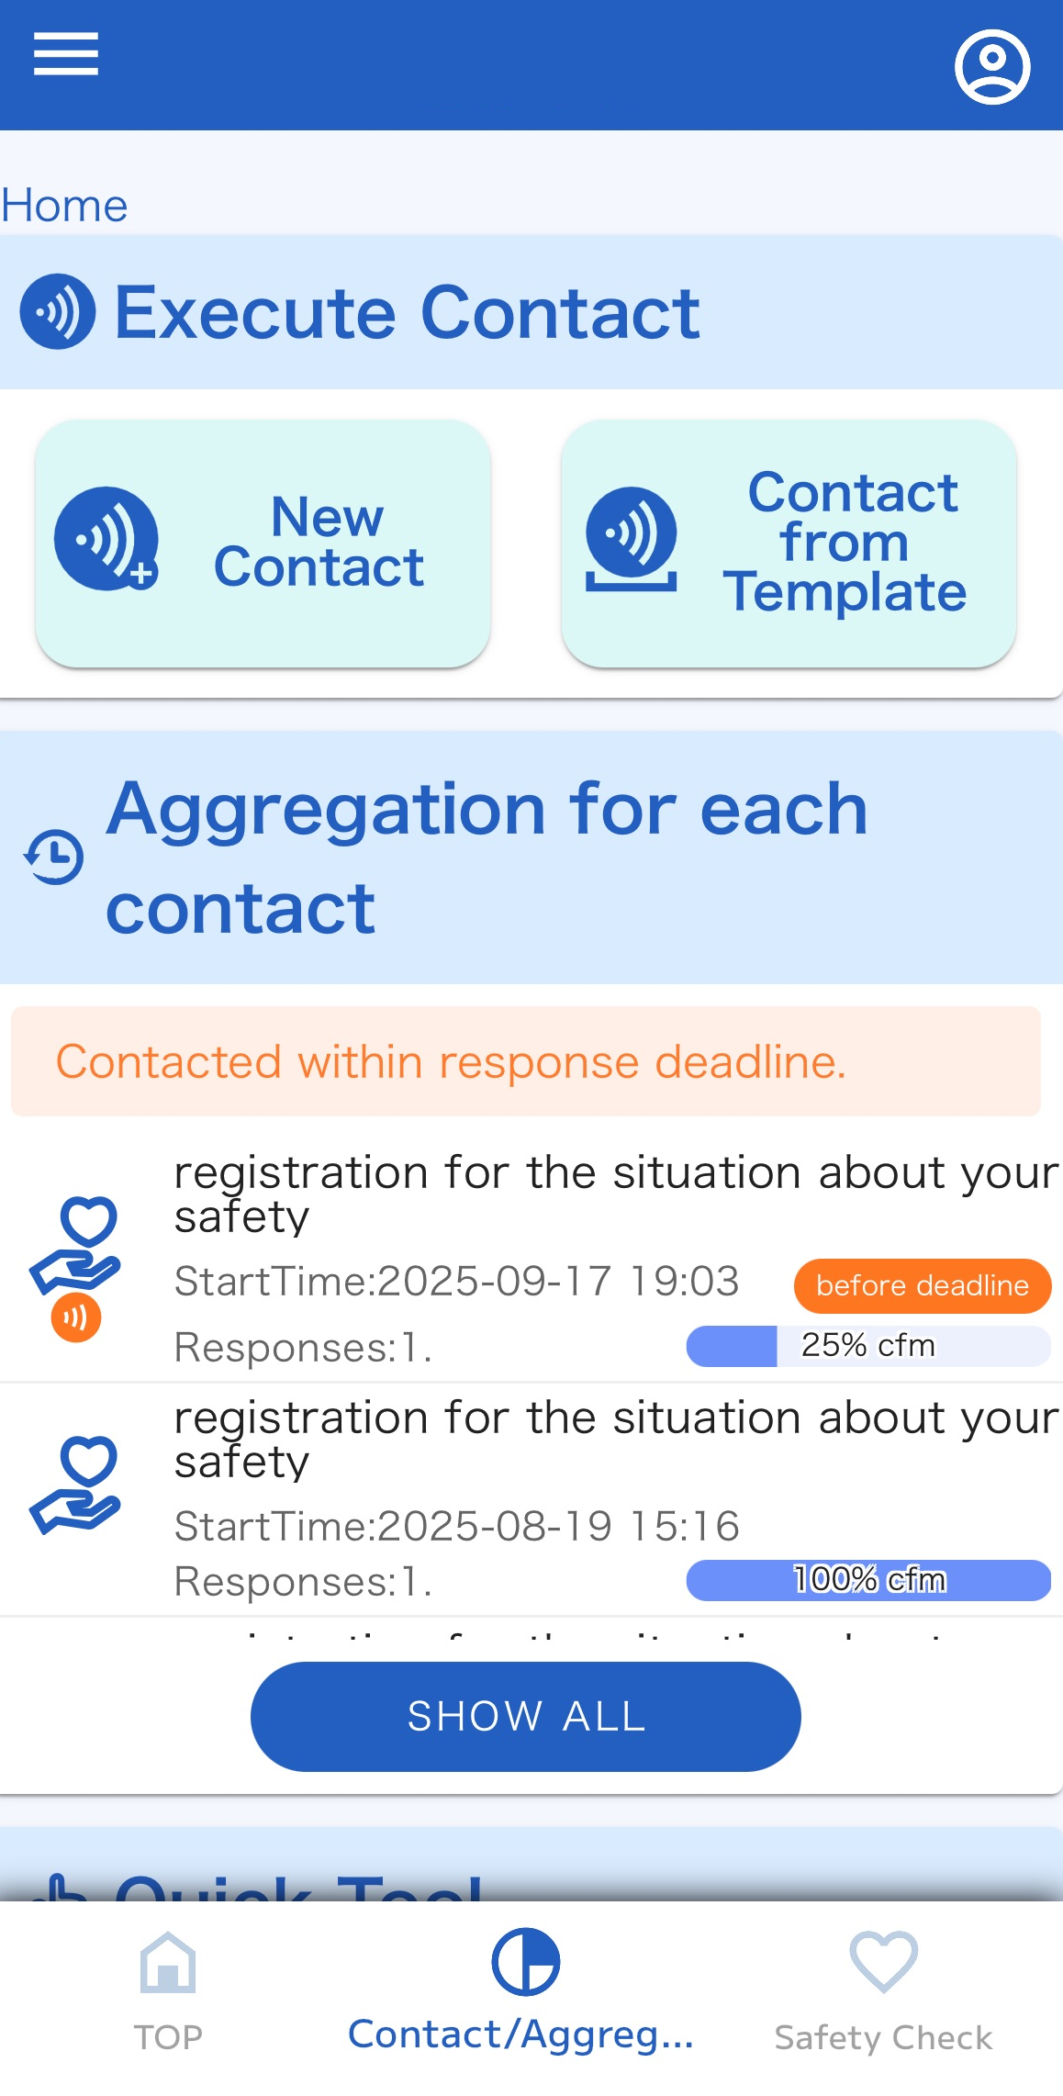
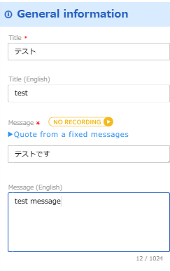
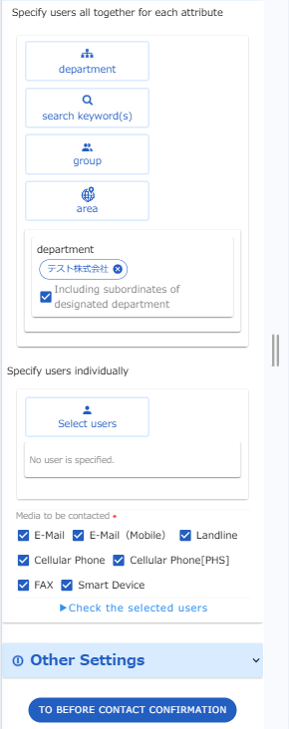
1．Start Contact
（1） New contact
1. Tap “Contact/Agrreg..” menu.
2. Tap “NewContact.” button.
3. Create the contact contents.
4. Click “TO BEFORE CONTACT
CONFIRMATION ” button.
2

Slide 4
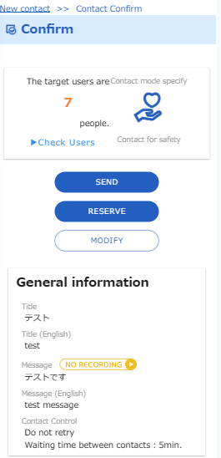
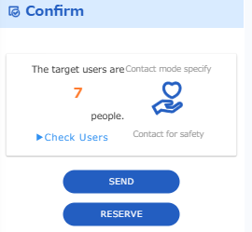
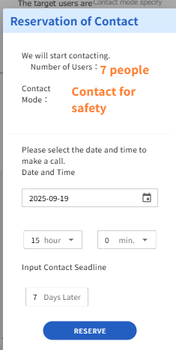
5 .After confirming the contents, proceed to the sending step.
If you want to make an immediate call, click “SEND”button.
If you want to specify start date and time, click “RESERVE“ button.
【SEND】
【RESERVE】

Slide 5
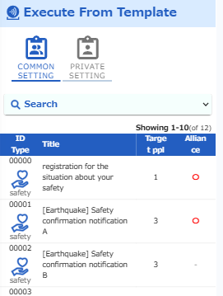
（2） Contact using Templates
By creating your contact information in advance, you can quickly make a call in the event of an emergency. The content of the communication is called a "template".
1. Tap “Contact/Agrreg..” menu.
2. Tap “Contact form Template”
button.
3. Tap the template you want
to send.

Slide 6
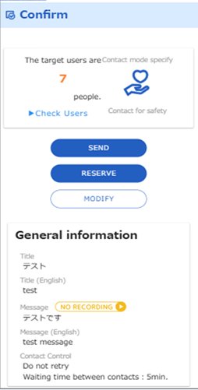
4 .After confirming the contents, proceed to the sending step.
If you want to make an immediate call, click “SEND”button.
If you want to specify start date and time, click “RESERVE“ button.
【SEND】
【RESERVE】

Slide 7
2. Aggregation
(1) Aggregation for each contact
1. Tap “Contact/Agrreg..” menu.
2. Select the contacts you want
to aggregate from
"Aggregation for each contact“

Slide 8
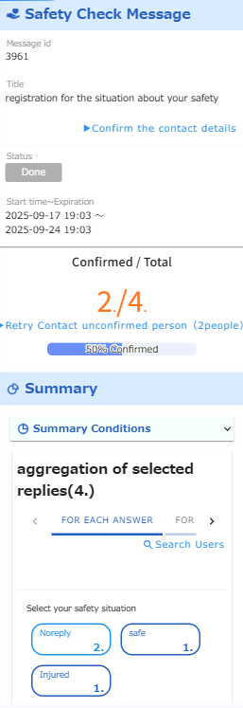
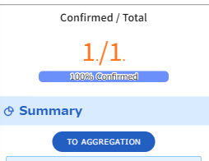
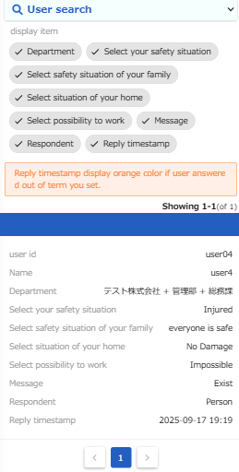
3. The aggregated results will be
displayed.
*If the response Expiration has passed, select the “TO AGREGATION" button.
4. Select the answer you
want to check.
5. The target user will be displayed.

Slide 9
(2) Confirming Contact Status.
You can check the response rate trends and status of contact.
1. Tap “Contact/Agrreg..” menu.
2. Select the contacts you want
to aggregate from
"Aggregation for each contact“

Slide 10
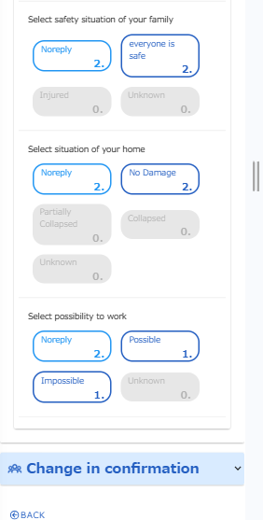
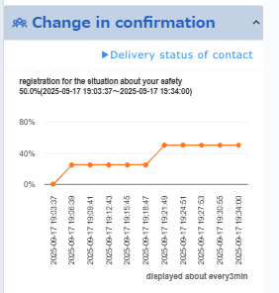
3. Select “Change in confirmation”
button.
4. A response rate graph will be displayed.
5. To check the details of the
call status, click
“Delivery status of contacts".
button.

Slide 11
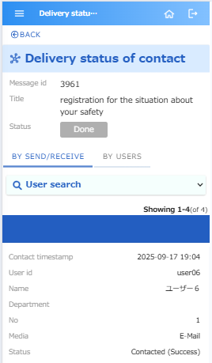
6. The contact date and time
and status information will be
displayed.

Slide 12
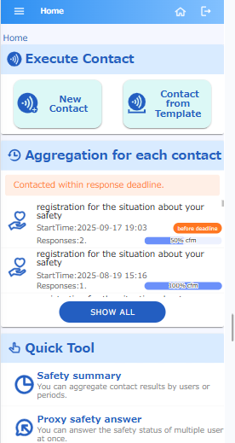
（3） Aggregate together
If the mode of contact is "Safety", you can aggregate multiple contact at once.
（3）-1 Aggregate all users in authority
1. Tap “Contact/Agrreg..” menu.
2. Tap “ Safety summary” button.

Slide 13
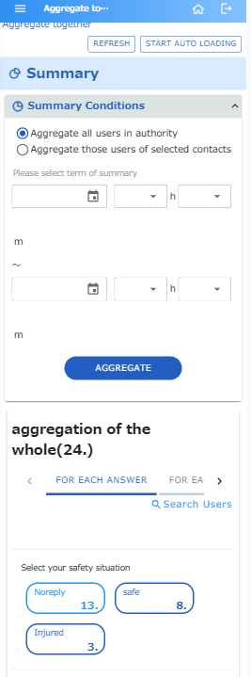
3. Select
“Aggregate all users in authority “
4. Tap “AGGREGATE” button.
5. The aggregated results will be
displayed.

Slide 14
（3）-1 Aggregate multiple contact
1. Tap “Contact/Agrreg..” menu.
2. Tap “ Safety summary” button.

Slide 15
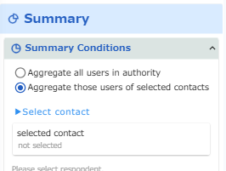
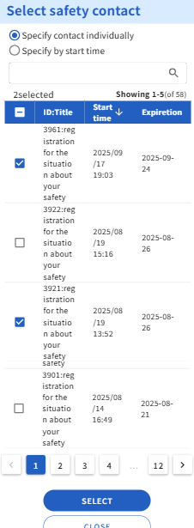
3. Select “Aggregate those
users of selected contacts “
4. Tap “ Select contact“
5．Check the contact you
want to select
6．Tap “SELECT” button.

Slide 16
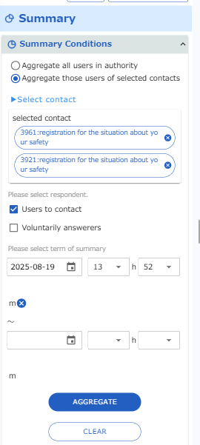
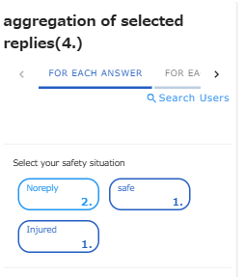
7．Select respondent.
“Users to contact” or “Voluntarily answerers ” button.
8．Tap “AGGRIGATE” button.
9. The aggregated results will be
displayed.

Slide 17
3. Proxy safety answer
If you have aggregation authority , you can answer proxy of multiple users at once.
1. Tap “Contact/Agrreg..” menu.
2. Tap “ Proxy safety answer”
button.

Slide 18
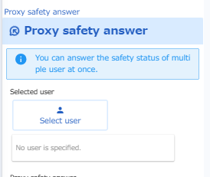
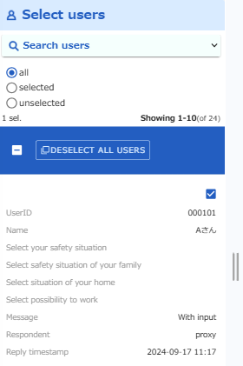
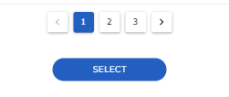
3. Tap “Select user” tab.
4．Check the user you want
to select
5．Tap “SETECT” button at
the bottom of the screen.

Slide 19
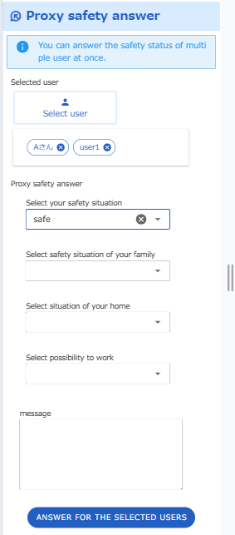
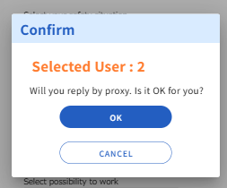
6．Select answer from the
lists.
7．Tap“ ANSWER FOR THE
SELECTED USERS”
8. Tap “OK” button.

