Slide 1

APP manual
～ User Guide ～
Infocom Corporation
Update：2026/5/20
Copyright INFOCOM CORPORATION All rights reserved

Slide 2
Table of contents
This manual describes the initial setup, responses, and contact registration for the Emergency Call Ver. 6 smart device app (app).
For operations such as outgoing calls and counting, please refer to the manager's manual.
1． Set language
P2
2．APP Setup
(1) The App setup from the smart device web
(2) The Application setup from the PC web
P3
3． Answer safety status
(1) How to Answer tap on message
(2) How to Answer open APP
P7
4． Registering Contacts
P9
＜Supported OS ＞
iOS 17、18
Android 8、9、10、11、12、13、14、15、16
*We have a policy of supporting the latest OS.

Slide 3
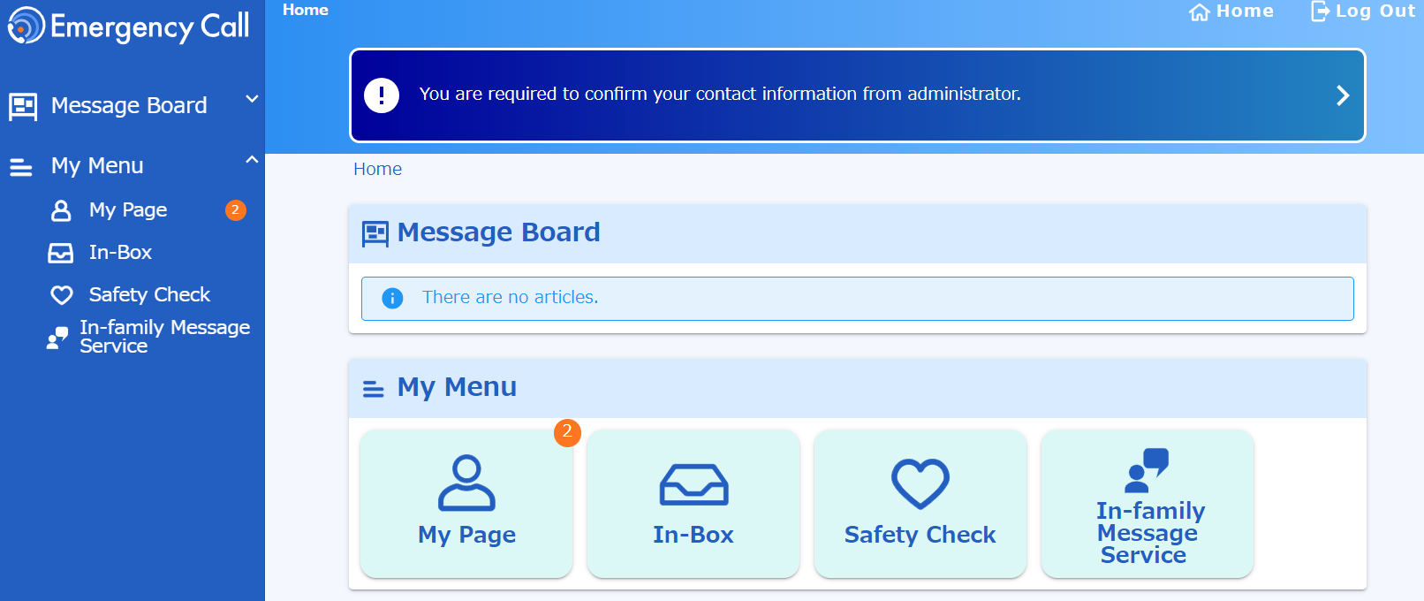
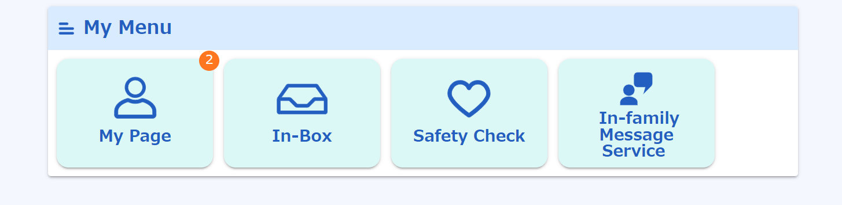
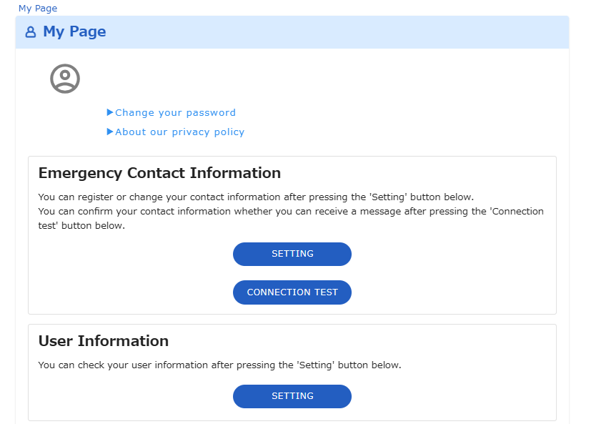
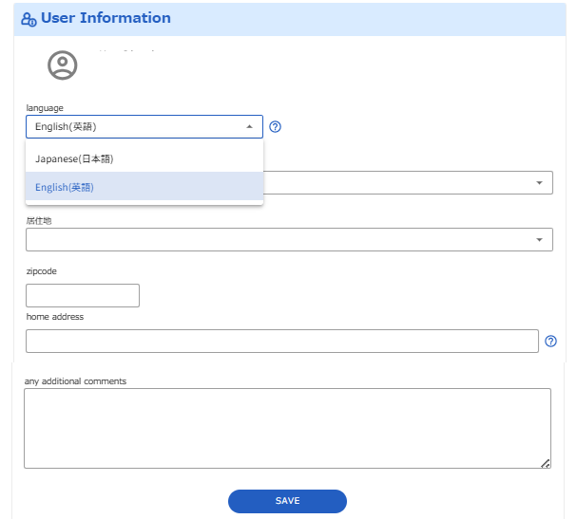
１. Set language
First, set the language to English. If you have already done, this step is not necessary.
1. To access Emergency Call site (Web）
from PC or smart device.
Click on "My Page“ menu.
2. Click on “SETTING“ button in User Information.
3. Select "English(英語)" in the
language section.
4. Click on “SAVE“ button.

Slide 4
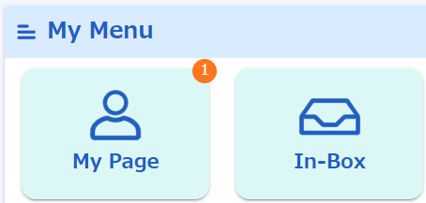
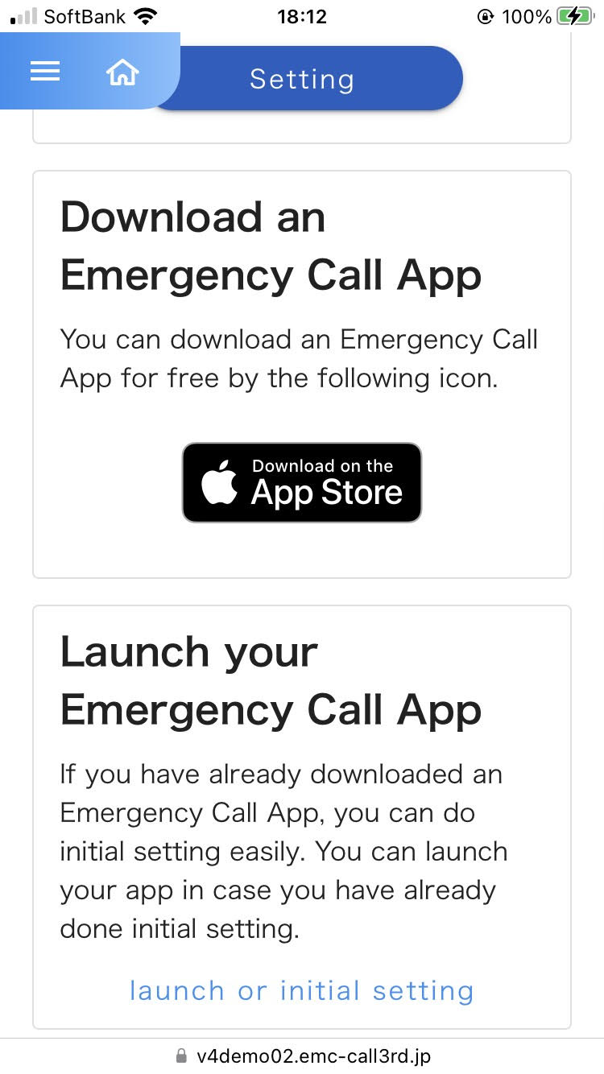
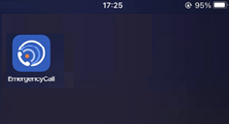
２. APP Setup
(1) The App setup from the smart device web
●How to install the App from the smart device web
1. To access Emergency Call site (Web)
from smart device.
2. Tap “My Page" menu.
3. Tap “AppStore” or “Google Play”
* You need "Apple ID" or "Google Account" to install the application.
4. The icon of the application appears on
your device.

Slide 5
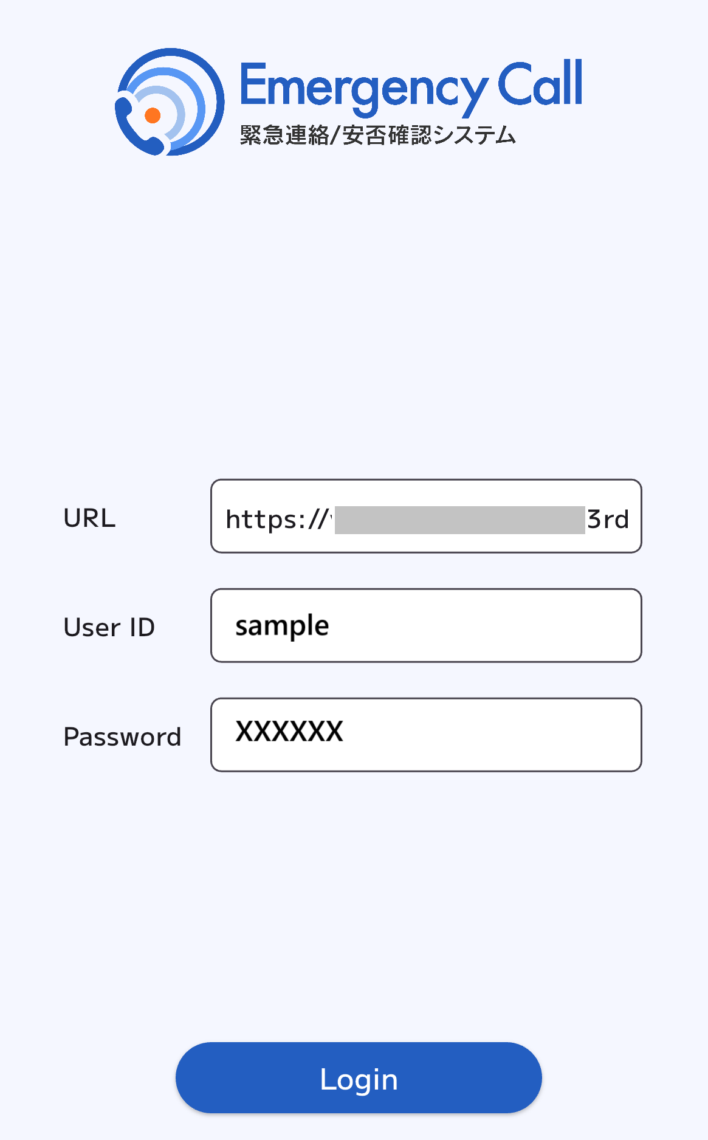
● Initial Setting of the App from the smart device web
1. To access Emergency Call site (Web）
from smart device.
2. Tap “My Page" menu.
3. Tap "Launch or Initial Setup" bottom.
The initial setup screen with URL and
User ID will appear. Enter your
“Password”.
5. Tap the "Login” button.
Once the “My Menu" screen appears, setup is complete.
4

Slide 6
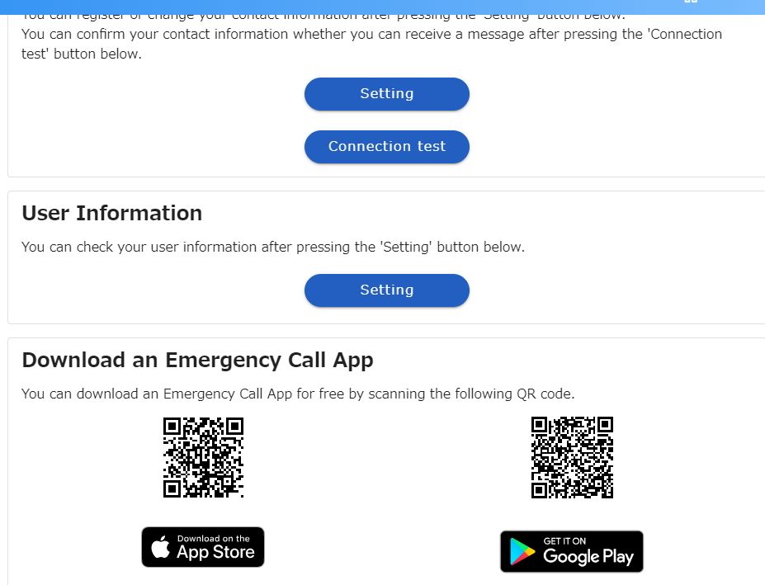
(2) The Application setup from the PC web
●How to install the application from the PC web
1. To access Emergency Call site (Web）
from PC.
Click on "My Page“ menu.
2. You can download an Emergency
Call App by scanning the QR
code.
※If you can’t scan the QR code from the standard camera app, please try from Smart device.
3. The icon of the application appears on
your device.
5

Slide 7
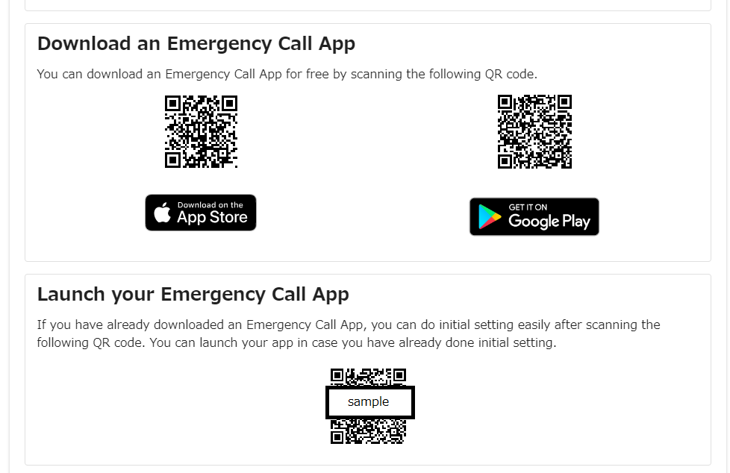
●Initial Setting of the App ｆrom the PC Web
1. To access Emergency Call site (Web）
from PC.
Click on "My Page“ menu.
2. You can initial setting an
Emergency Call App by scanning
the QR code.
(“Launch your Emergency Call App”
menu)
※If you can’t scan the QR code from the standard camera app, please install readable camera app.
The initial setup screen with URL and
User ID will appear. Enter your
“Password”.
5. Tap the "Login” button.
Once the “My Menu" screen appears, setup is complete.
6

Slide 8


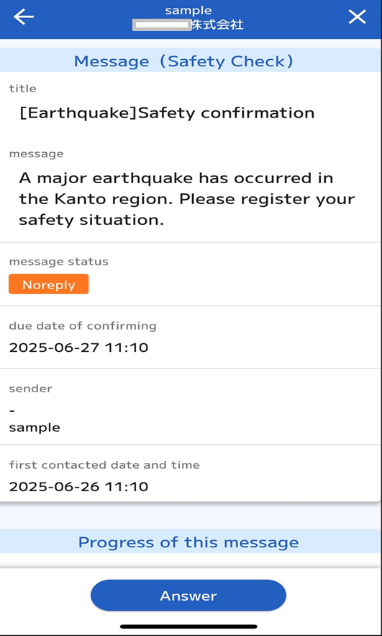
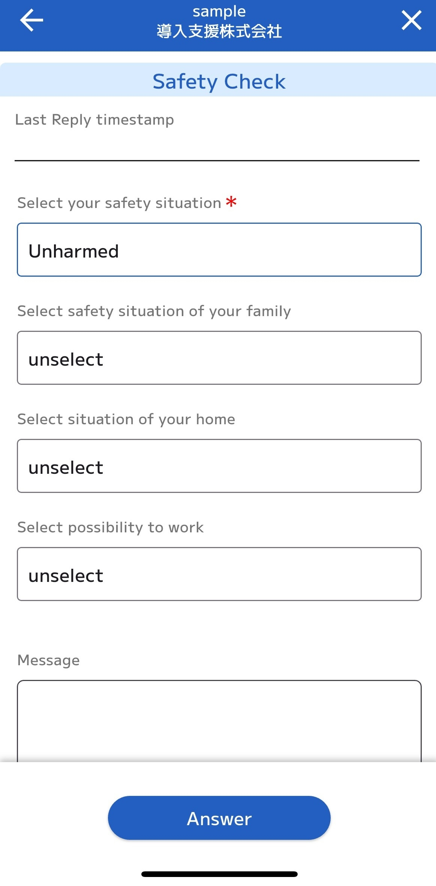
3. Answer safety status
(1) How to Answer tap on message
When emergency messages
are received, this message appears
at the top of the screen.
Tap on the message.
2. Tap on the “Answer”
3.Select the answer to each of the items listed.
.Tap on “Answer” button.

Slide 9
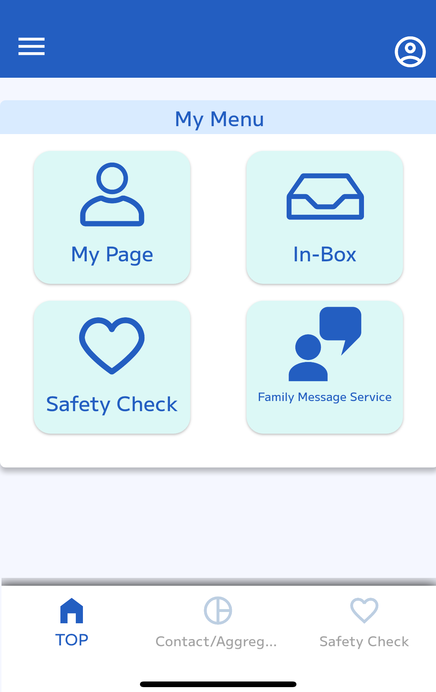
(2) How to Answer open APP
1. Open the App.
.
2. Tap on the “Safety Check”
3.Select the answer to each of the items listed.
.Tap on “Answer” button.

Slide 10
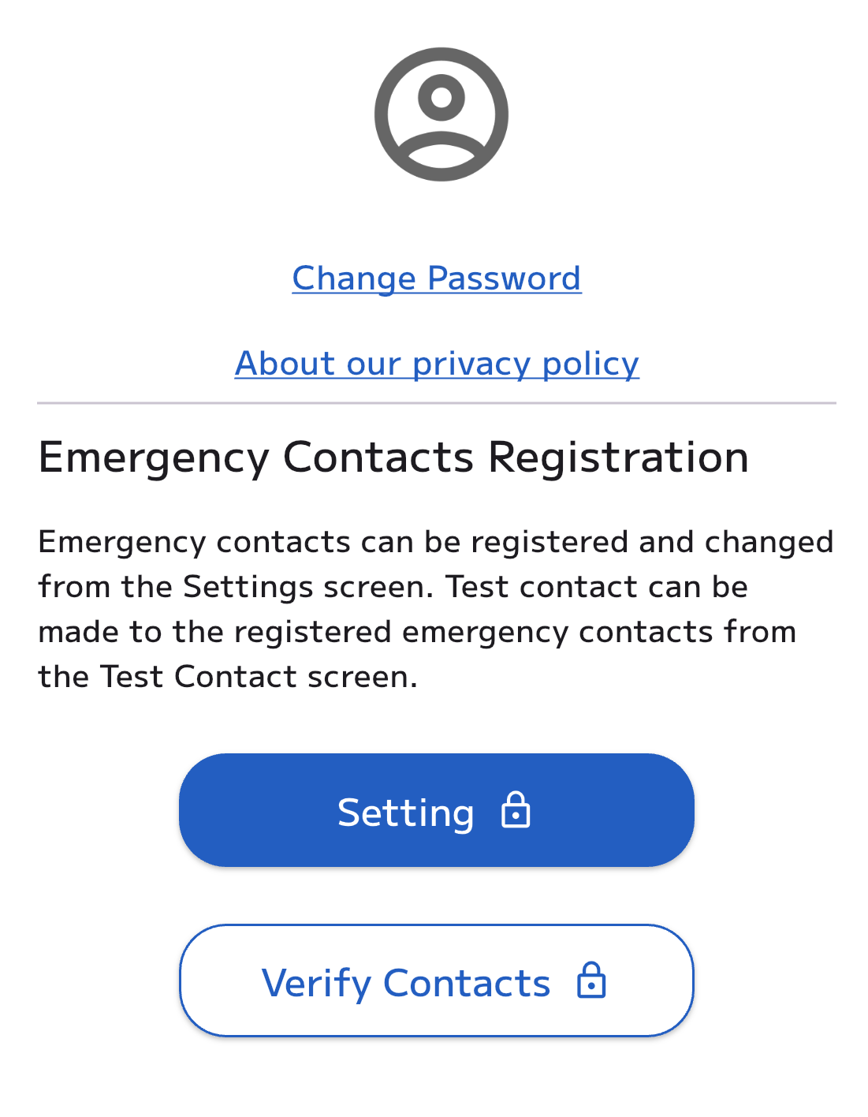
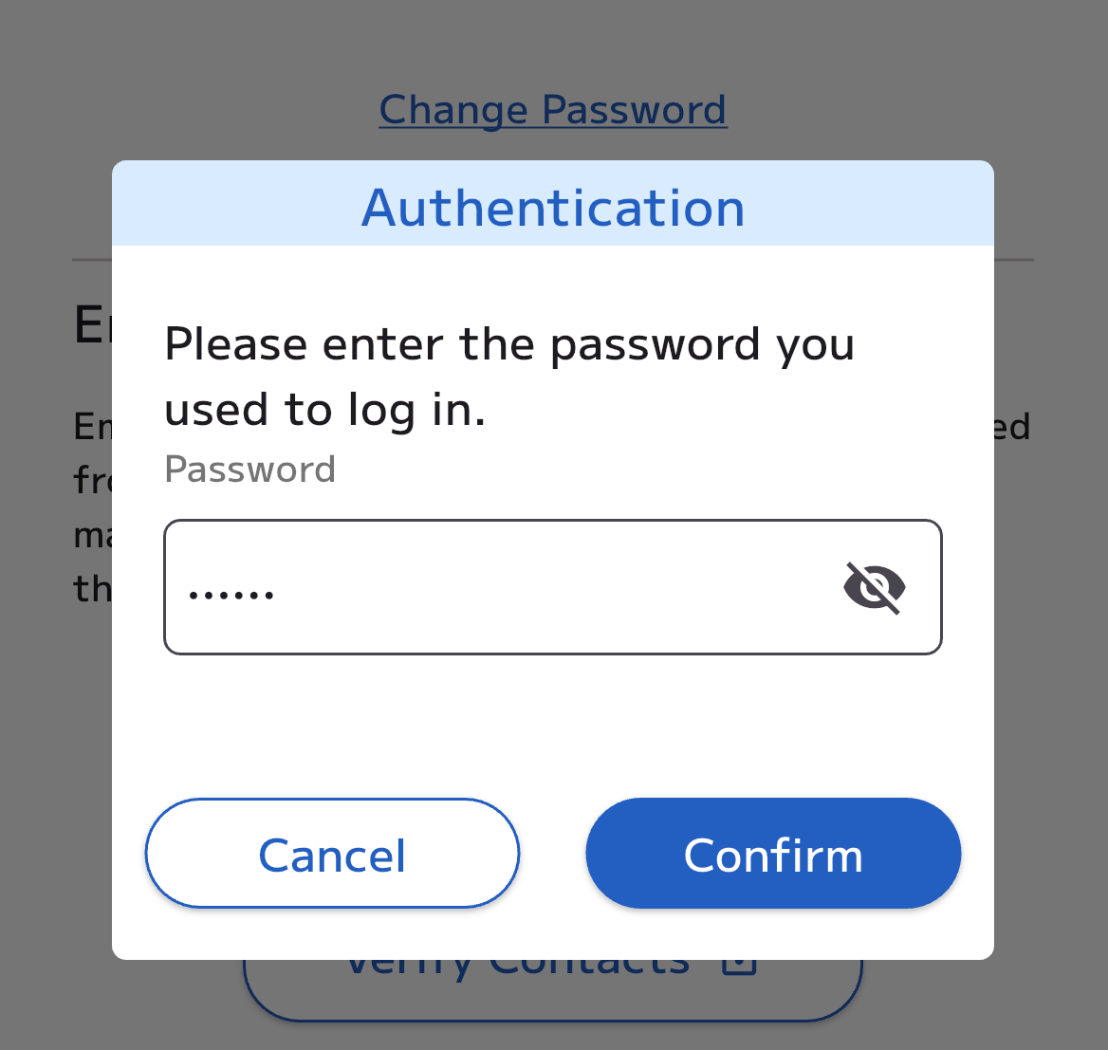
4. Registering Contacts
1. Tap on the “My Page”
2. Tap on "Setting“ menu.
3. Enter the password you used
to log in.
Tap on “Confirm” button

Slide 11
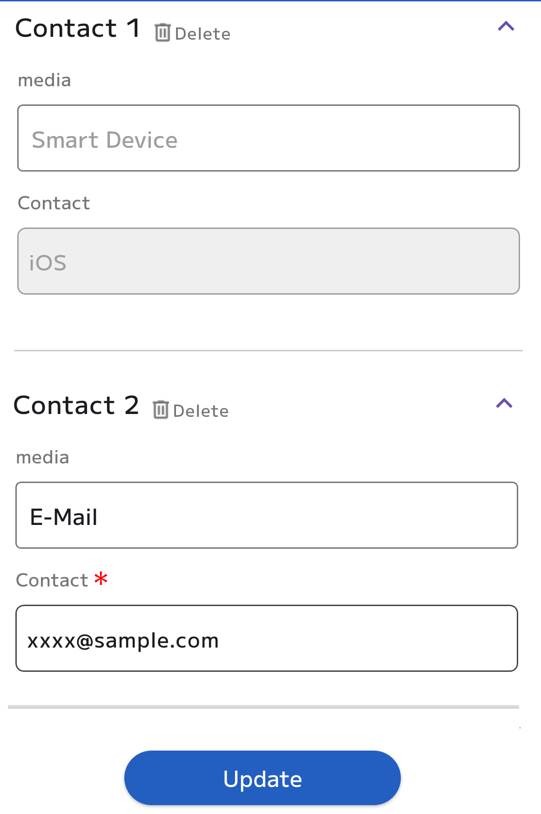
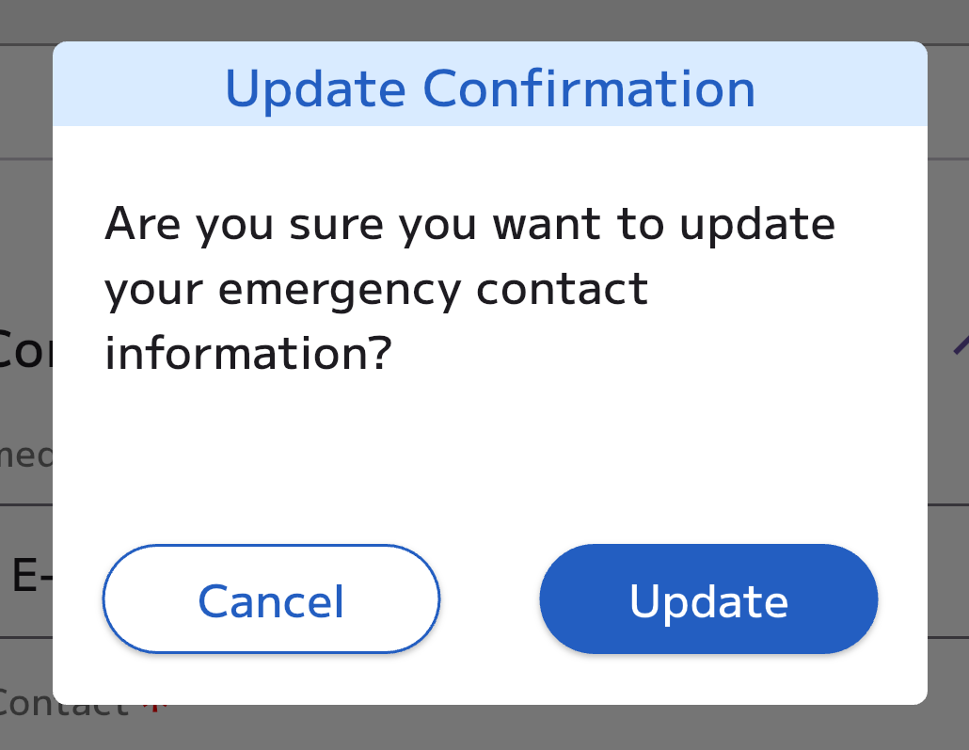
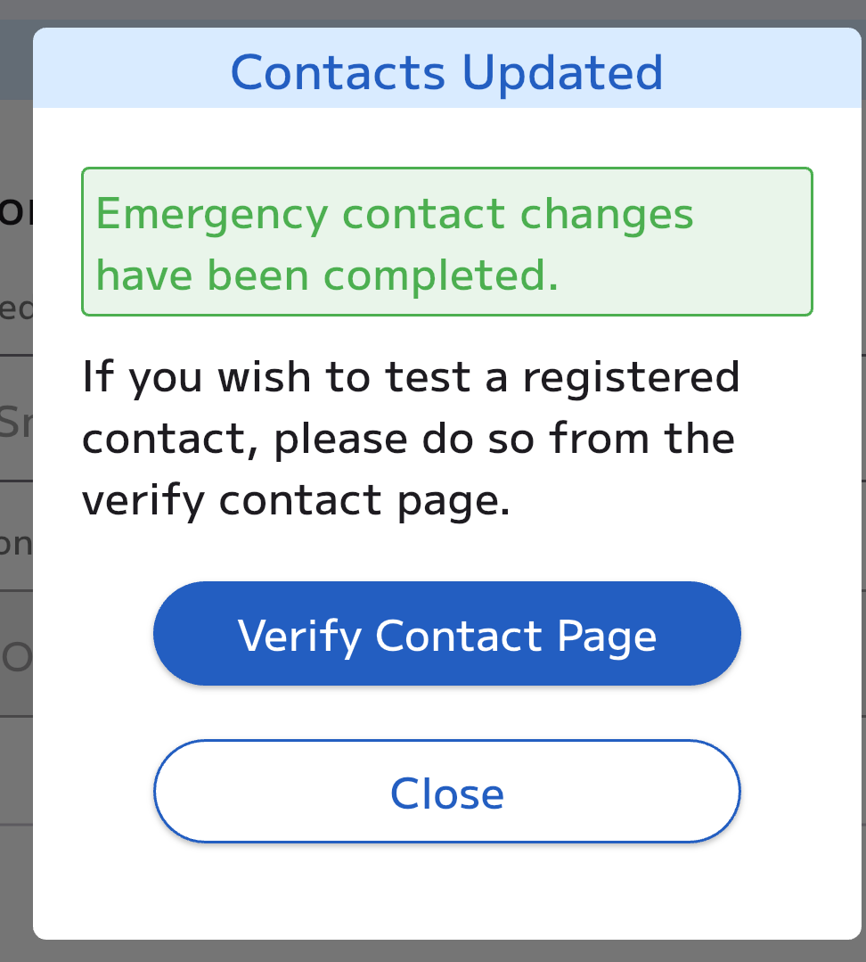
4. Select the registration medium from the list and enter the contact information.
5. Tap on “Update” button.
6. Tap on “Update“ button.
Tap on
“Verify Contact Page“ button.
To ensure the registered email addresses are correct and not blocked by spam settings, a test email will be sent from Emergency Call to confirm receipt.

Slide 12
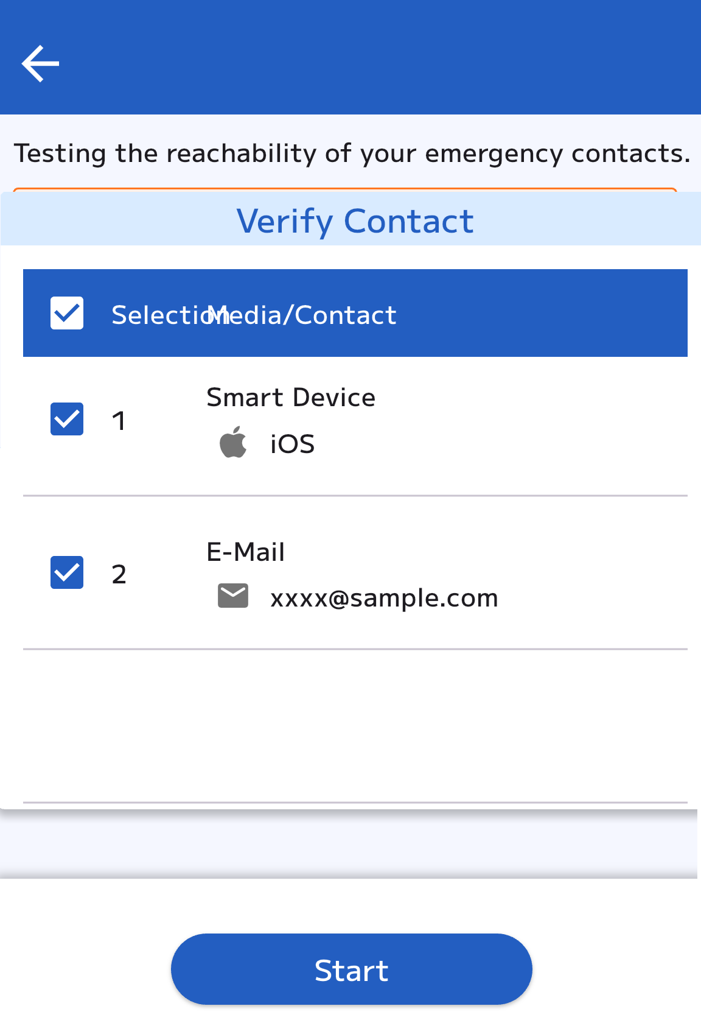
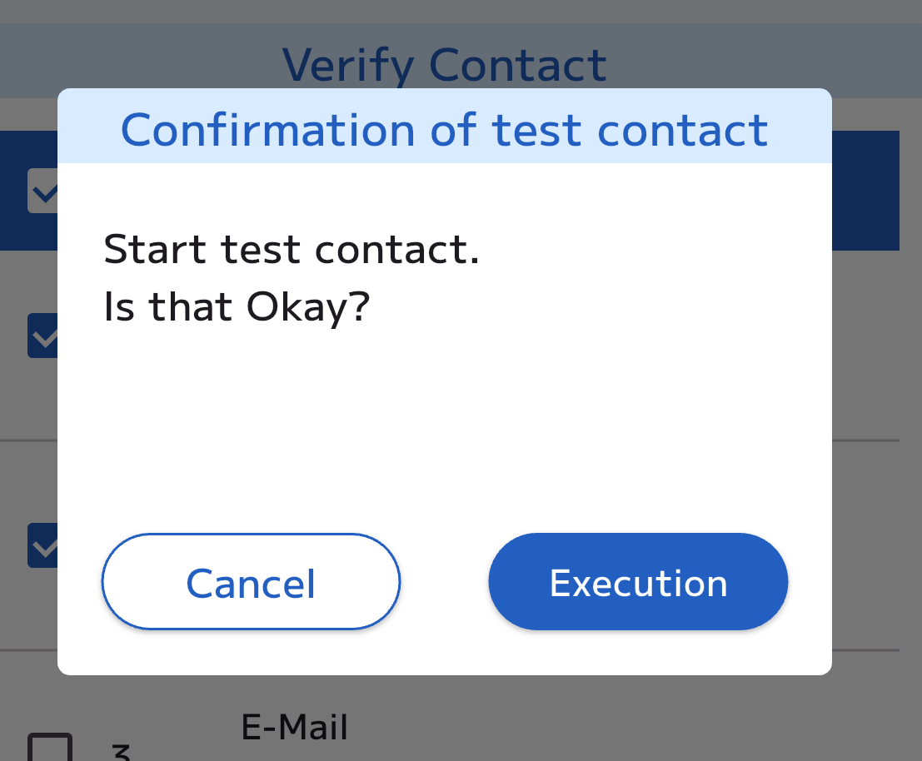
9. Select the contact you want to test, then click "Start".
10. Tap on “Execution”.
2017/11/21 17:41:45
Emergency contact confirmation test
This is an emergency call sending test. If you do not recognize this email, please delete it.
URL: https://xxxxx
11. If there are no issues with the registered email address, you will receive a test email as shown on the left.
Test contact completed.

