Slide 1

Version 6.2
Manager Guide
Guide
【URL】
https://
https://
【 Mail Address 】
Infocom Corporation
Update：2025/8/28
Copyright© INFOCOM CORPORATION All rights reserved

Slide 2
Table of contents
1．Login
(1) Access the web site
(2) In case you forgot your password
P2
2．Start Contacts
(1) New Contacts
(2) Contact using Templates
P4
3．Aggregation
(1) Aggregation for each contact
(2) Confirming Contact Status.
(3) Aggregate together
P8
4．Proxy safety answer
(1) Proxy safety answer
P15

Slide 3


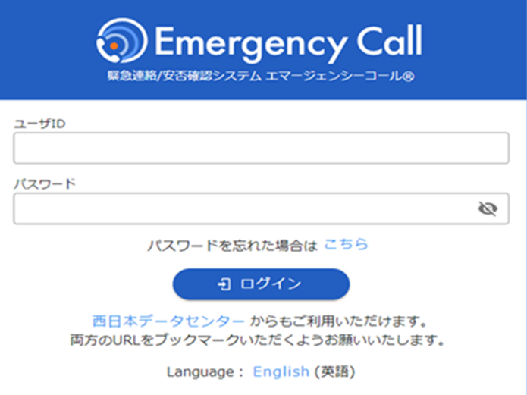
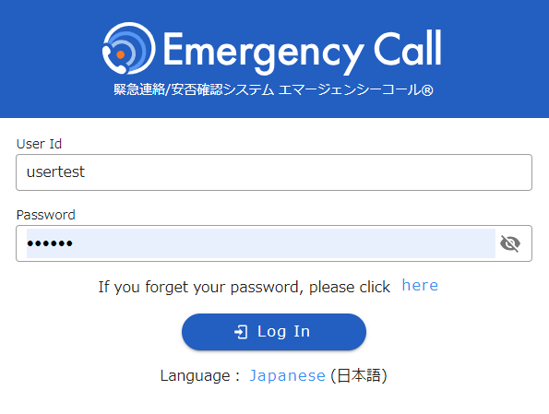
Login
Start Contacts
Aggregation
Proxy answer
1. Login
(1) Access the web site
1. To access Emergency Call from an
Internet-connected PC or smart device
enter its URL
in the address bar of your browser and
go to the web site.
1.
2. Click “English” at the bottom of screen.
2.
4. When login screen comes up, enter User Id
and Password, then click “Login” button.
※ If you add Login page to “Favorites,” this step can
be done more easily afterward.
3.

Slide 4
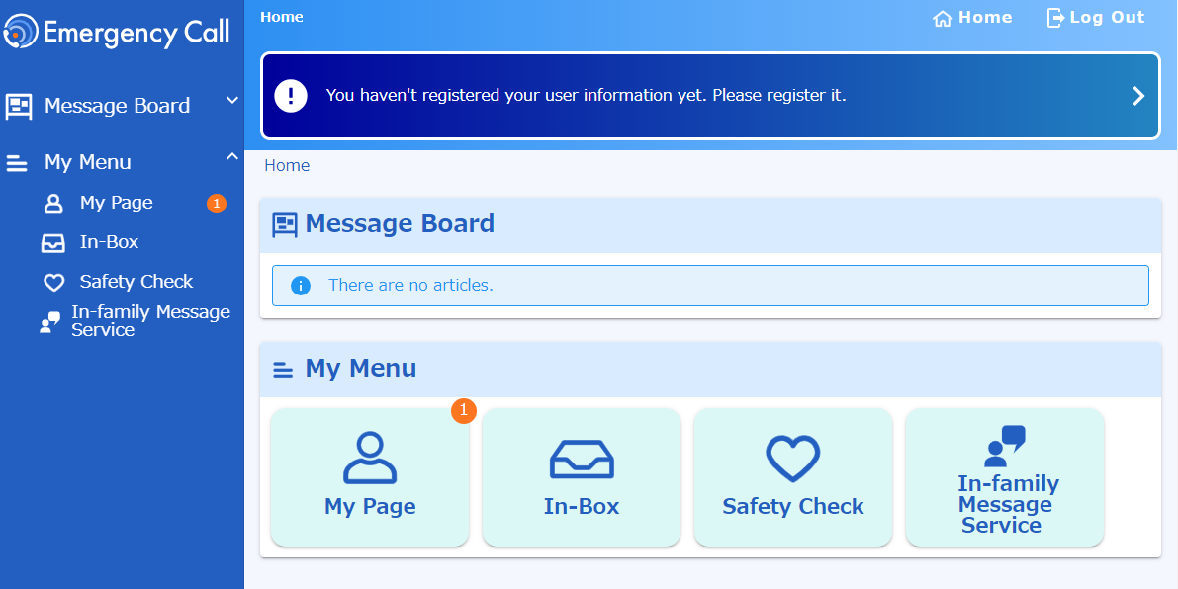

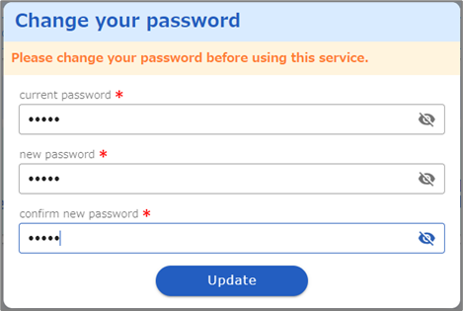
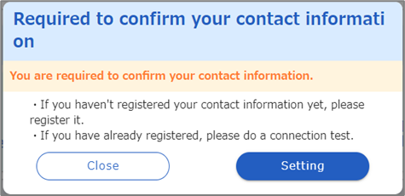
Login
Start Contacts
Aggregation
Proxy answer
5. When User menu comes up, you are logged in.
Change your password
If the password change screen appears, change the initial password.
current password:
Enter the current password (initial password).
new password / confirm new password:
Enter the new password twice (up to 16 characters).
Click "Update".
Required to confirm
your contact infoｒmation
If ”Required to confirm your contact information”appears, click “Setting".

Slide 5
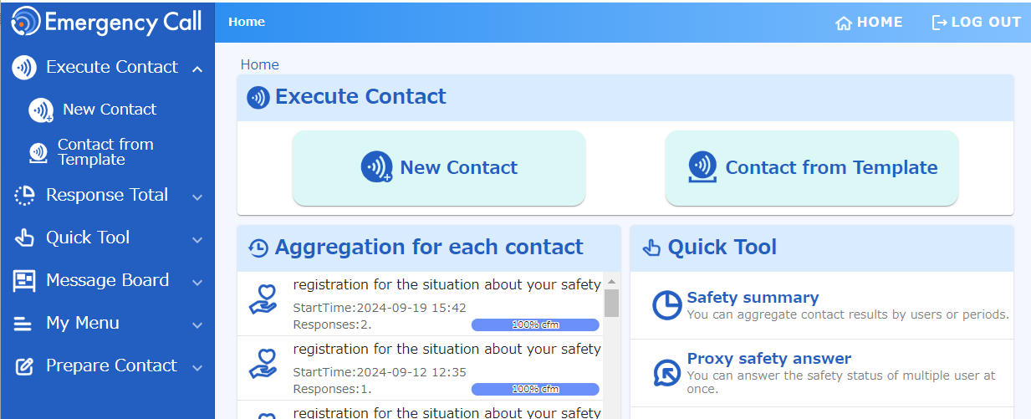
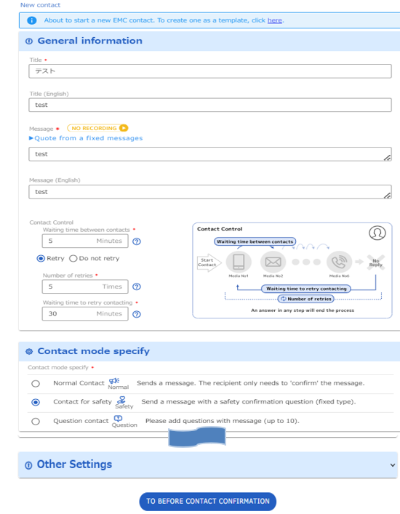
Login
Start Contacts
Aggregation
Proxy answer
２．Start Contact
Users who have been granted permission to "Execute Contact" can send messages and create/edit Templates.
（１） New contact
1. Click “New Contact” button
at the top of screen.
2. Create the contact contents.
3. Click “TO BEFORE CONTACT
CONFIRMATION ” button.
4

Slide 6
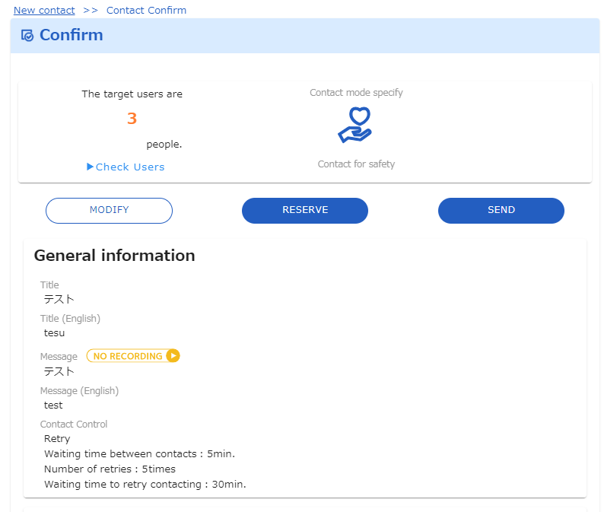
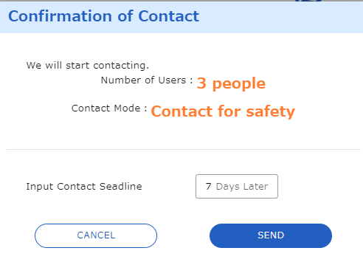
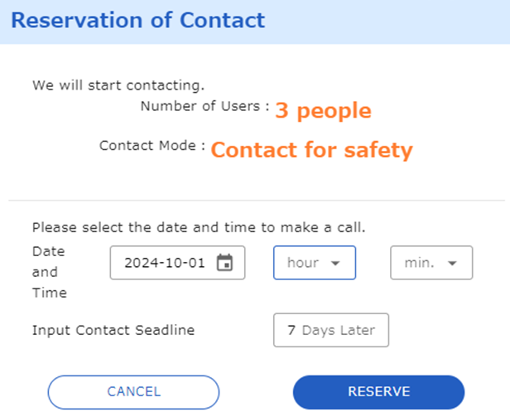
Login
Start Contacts
Aggregation
Proxy answer
4 .After confirming the contents, proceed to the sending step.
If you want to make an immediate call, click “SEND”button.
If you want to specify start date and time, click “RESERVE“ button.
【SEND】
【RESERVE】

Slide 7
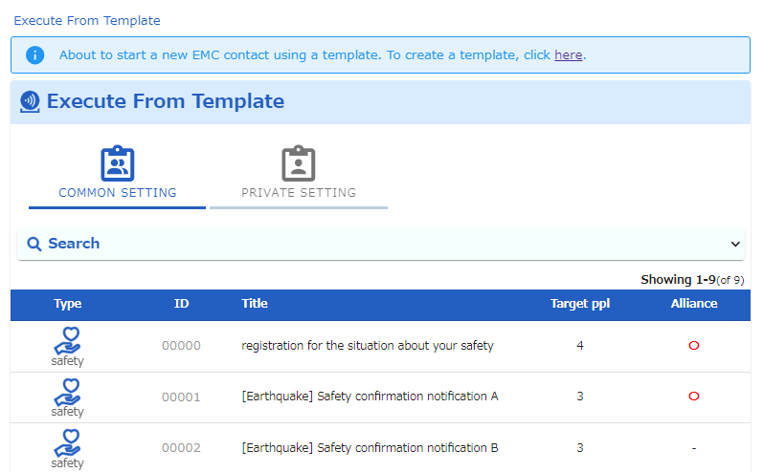
Login
Start Contacts
Aggregation
Proxy answer
（2） Contact using Templates
By creating your contact information in advance, you can quickly make a call in the event of an emergency. The content of the communication is called a "template".
1. Click “Contact from Template”
button at the top of screen.
2. Click on the template you want
to send

Slide 8
Login
Start Contacts
Aggregation
Proxy answer
4 .After confirming the contents, proceed to the sending step.
If you want to make an immediate call, click “SEND”button.
If you want to specify start date and time, click “RESERVE“ button.
【SEND】
【RESERVE】

Slide 9
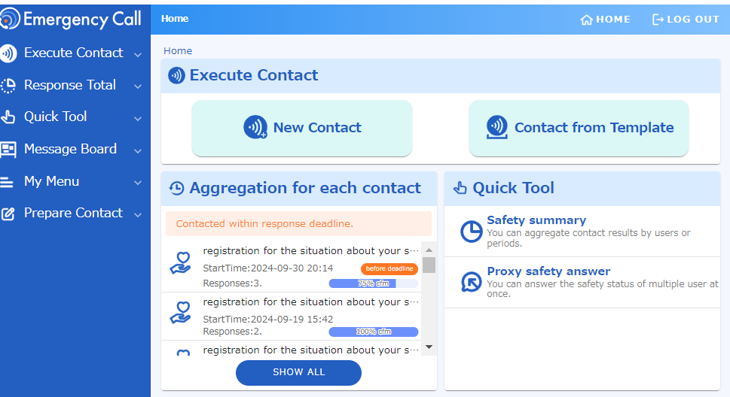
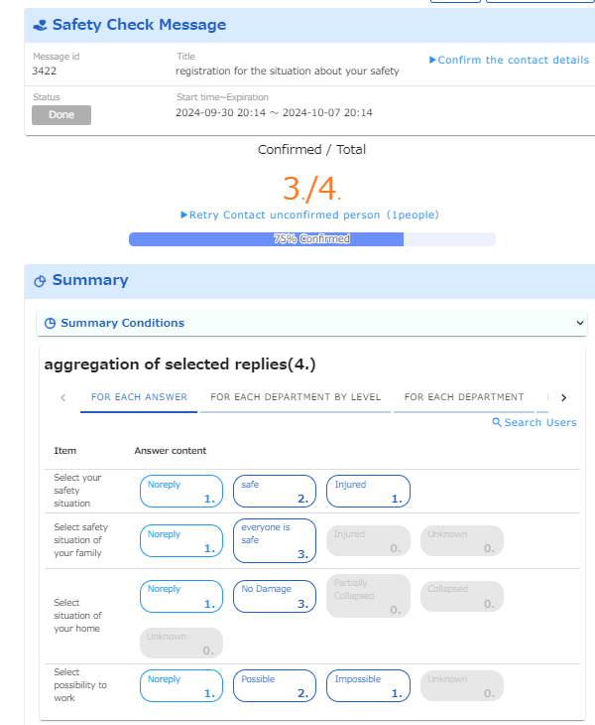
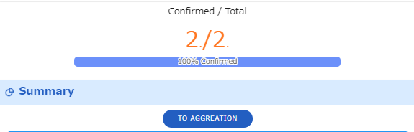
Login
Start Contacts
Aggregation
Proxy answer
4. Aggregation
(1) Aggregation for each contact
1. Select the contacts you want to aggregate from
"Aggregation for each contact“
2. The aggregated results will be
displayed.
*If the response Expiration has passed, select the “TO AGREGATION" button.

Slide 10
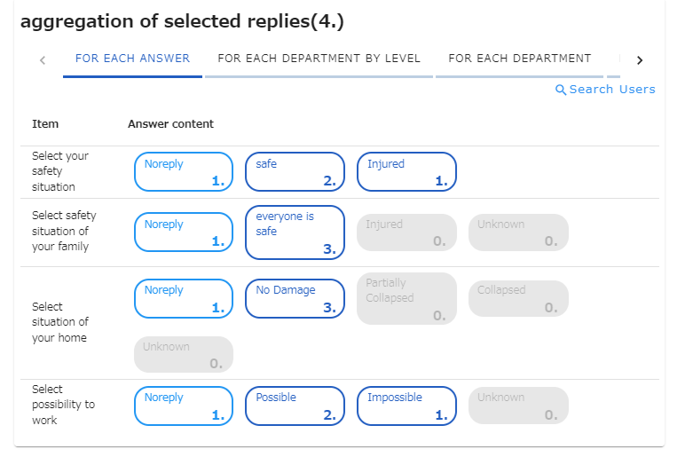
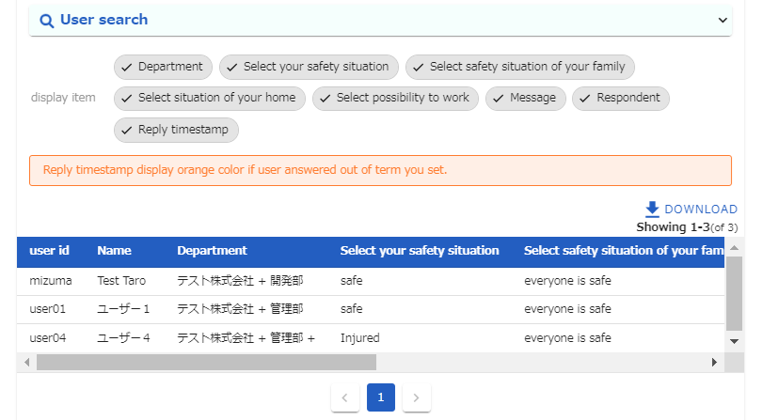
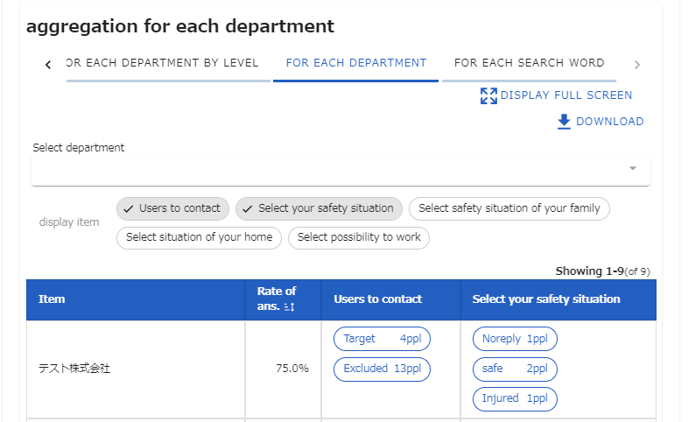
Login
Start Contacts
Aggregation
Proxy answer
3. Select the answer you want to check
4. The target user will be displayed.
＜FOR EACH DEPAETMENT ／ FOR EACH SEARCH WORD ＞
Aggregated results can be displayed by department or search word.

Slide 11
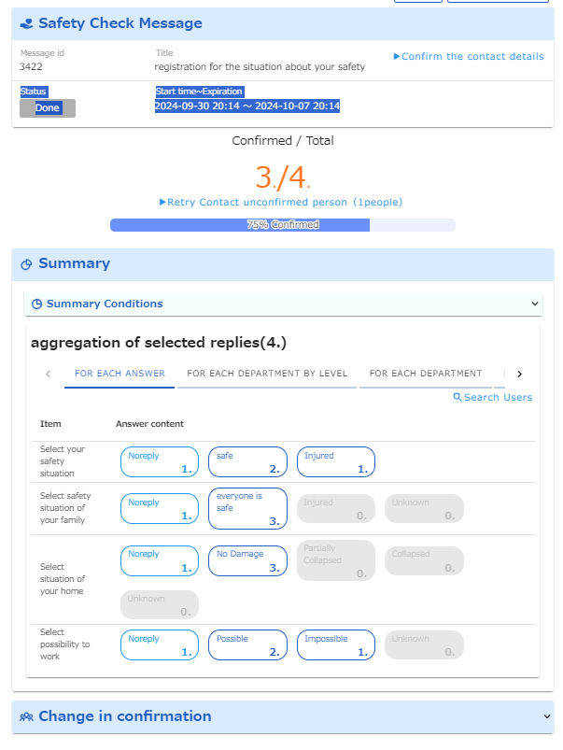
Login
Start Contacts
Aggregation
Proxy answer
(2) Confirming Contact Status.
You can check the response rate trends and status of contact.
1. Select the contacts you want to
confirm from
"Aggregation for each contact“
2. Select “Change in confirmation”
button.

Slide 12
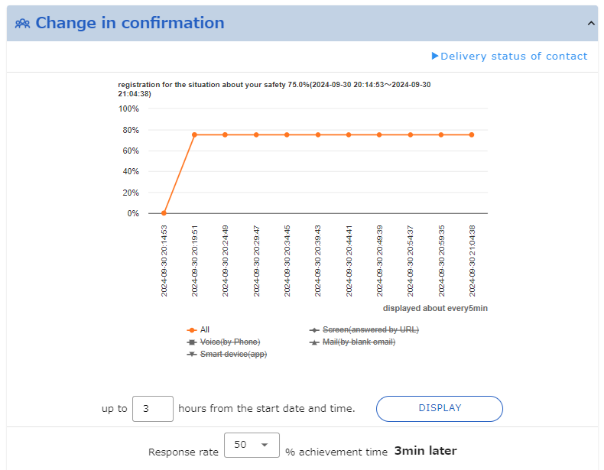
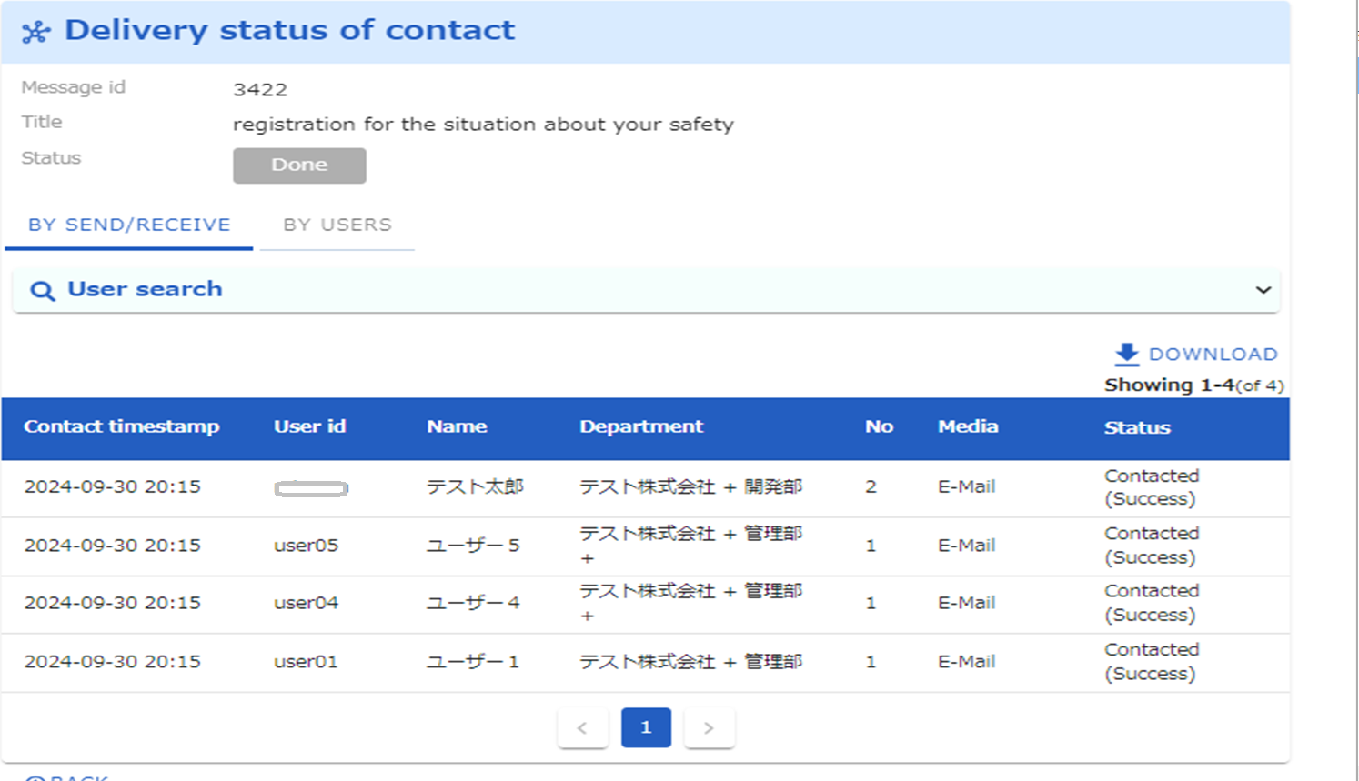
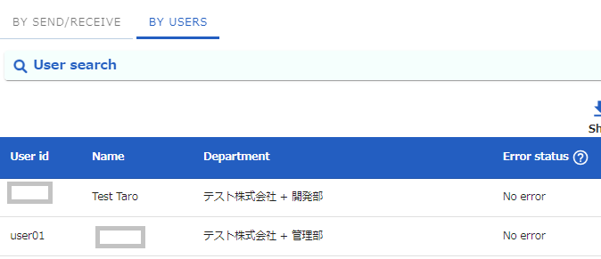
Login
Start Contacts
Aggregation
Proxy answer
3. A response rate graph will be displayed.
4. To check the details of the
call status, click
“Delivery status of contacts".
button.
5. The contact date and time
and status information will be
displayed.
＜BY USERS＞
From the "BY USERS" tab
You can check the status of each user.

Slide 13
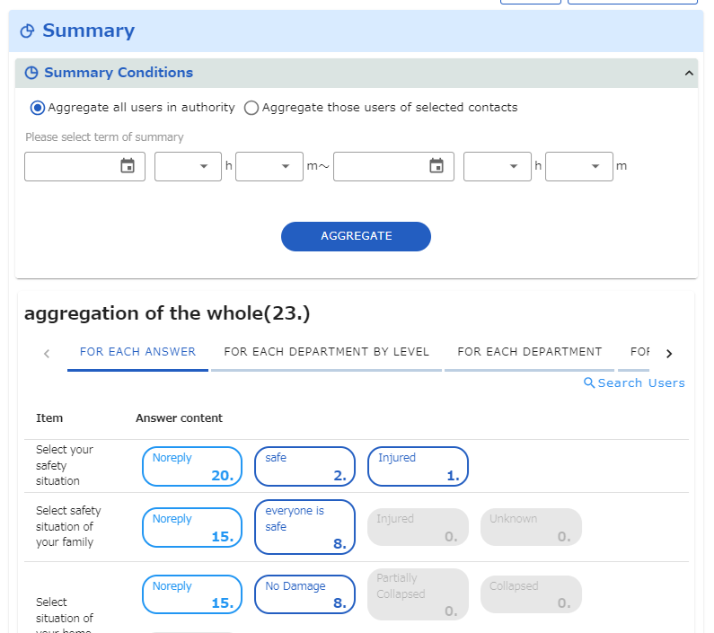
Login
Start Contacts
Aggregation
Proxy answer
（3） Aggregate together
If the mode of contact is "Safety", you can aggregate multiple contact at once.
（3）-1 Aggregate all users in authority
1. Click “ Safety summary”
button at the top of screen.
2. Select
“Aggregate all users in authority “
3. Click “AGGREGATE” button.
4. The aggregated results will be
displayed.

Slide 14
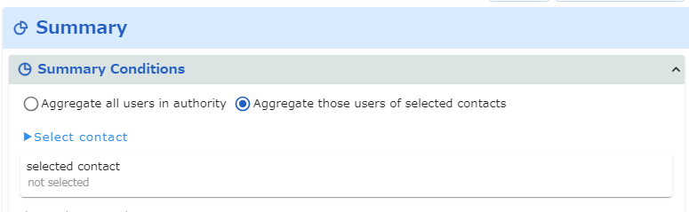
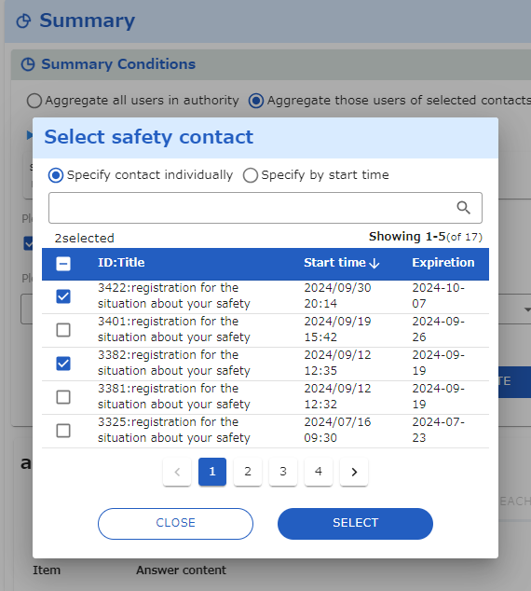
Login
Start Contacts
Aggregation
Proxy answer
（3）-1 Aggregate multiple contact
1. Click “ Safety summary”
button at the top of screen.
2. Select “Aggregate those users of selected contacts “
3. Click “ Select contact“
4．Check the contact you want to select
5．Click “SELECT” button.

Slide 15
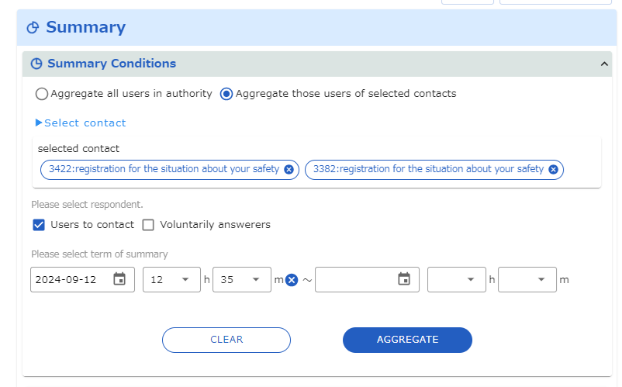
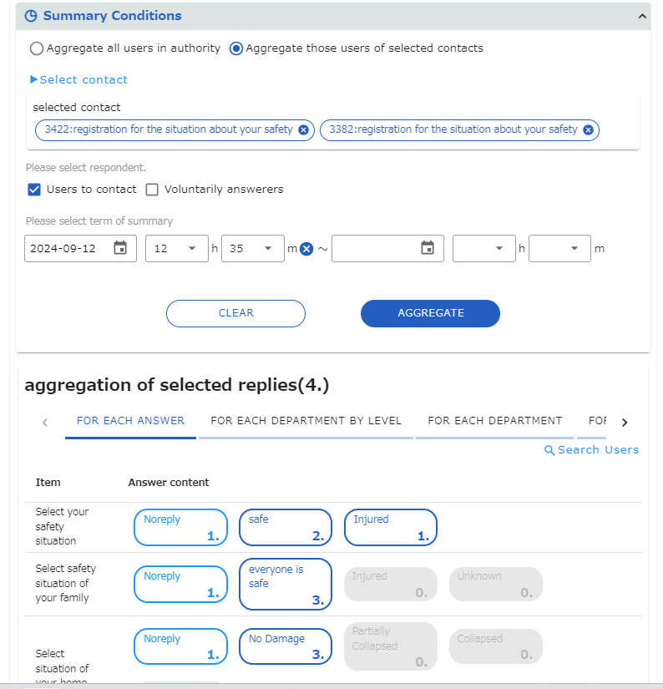
Login
Start Contacts
Aggregation
Proxy answer
6．Select respondent.
“Users to contact” or “Voluntarily answerers ” button.
7．Click “AGGRIGATE” button.
8. The aggregated results will be
displayed.

Slide 16
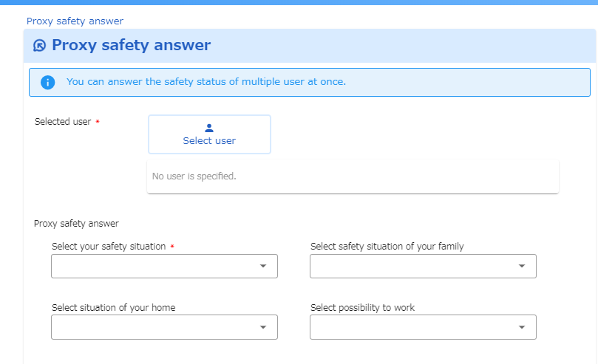
Login
Start Contacts
Aggregation
Proxy answer
4. Proxy safety answer
If you have aggregation authority , you can answer proxy of multiple users at once.
1. Click “Proxy safety answer”
button at the top of screen.
2. Click “Select user” tab.

Slide 17
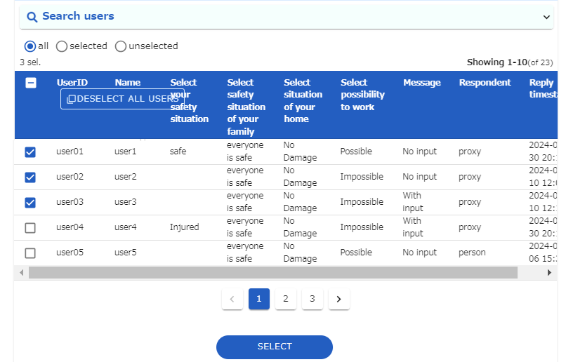
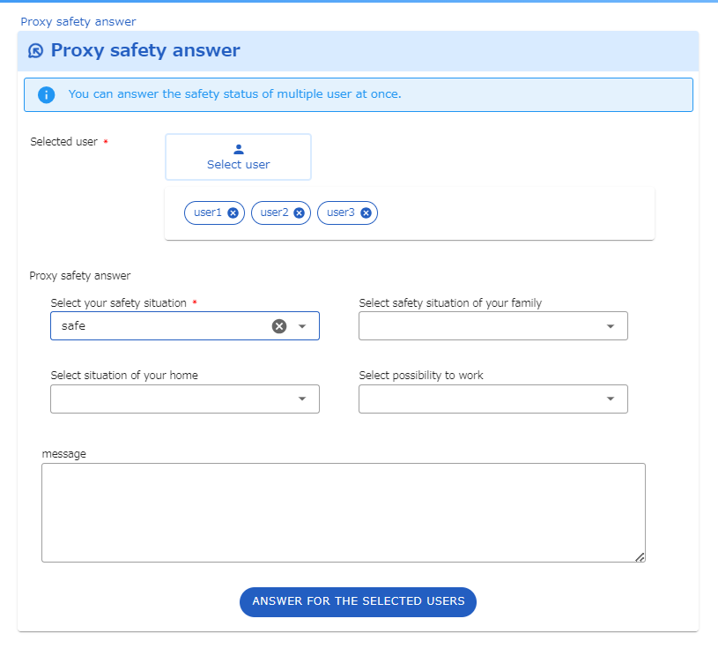
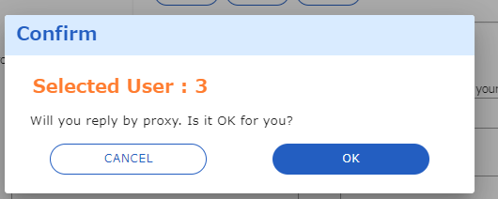
Login
Start Contacts
Aggregation
Proxy answer
4．Check the user you want to select
5．Click “SETECT” button.
6．Select answer from the
lists.
7．Click “ ANSWER FOR THE SELECTED USERS”
8. Click “OK” button.

