Slide 1

Version 6.2
User Guide
【URL】
https://
https://
【 Mail Address 】
Infocom Corporation
Update：2025/9/10
Copyright© INFOCOM CORPORATION All rights reserved

Slide 2
Table of contents
1．Login
(1 ) Access the web site
(2) In case you forgot your password
P2
2．Registering Contacts
(1) Registering Contacts
(2) Running tests
(3) The Language Selection
P6
3． Answer safety status
(1 ) When you get alerts
(2) Answer safety status without received alerts
P9
4．LINE ※optional features
(1) The LNE Appl setup
(2) How to respond using the LINE App
P18

Slide 3


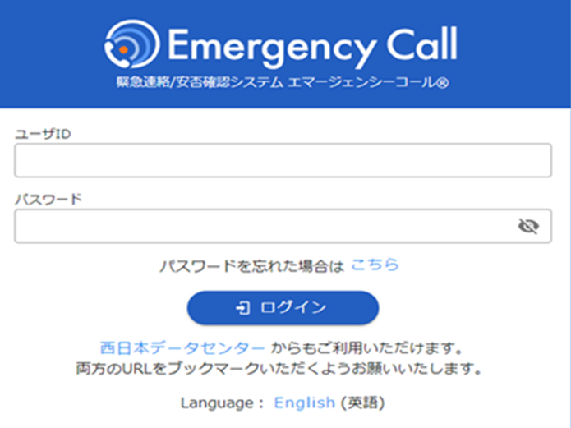
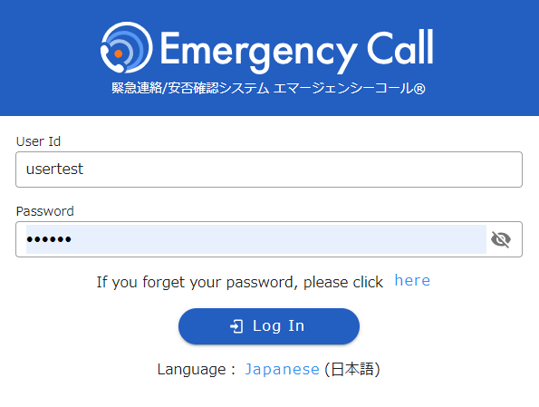
Login
Contacts
Answer
LINE
1. Login
(1) Access the web site
1. To access Emergency Call from an
Internet-connected PC or smart device
enter its URL
in the address bar of your browser and
go to the web site.
2. Click “English” at the bottom of screen.
.
3. When login screen comes up, enter User Id
and Password, then click “Login” button.
※ If you add Login page to “Favorites,” this step can
be done more easily afterward.
.

Slide 4
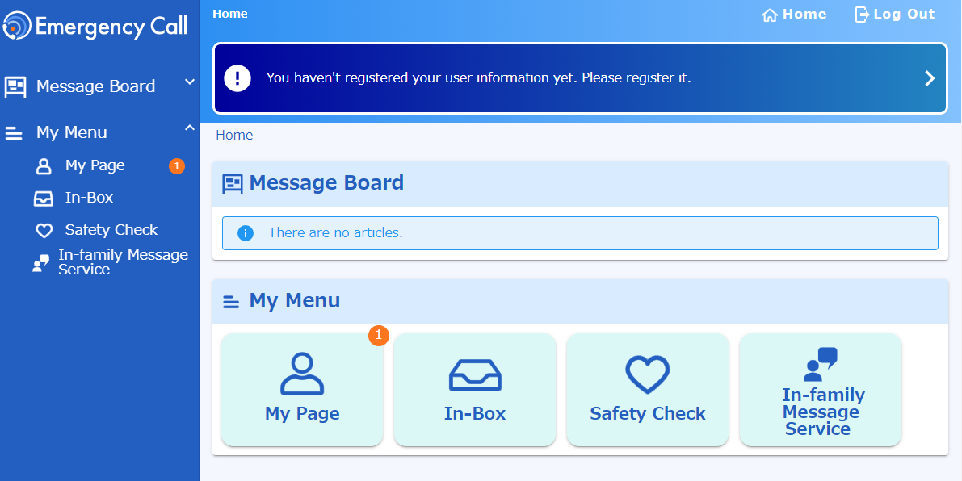

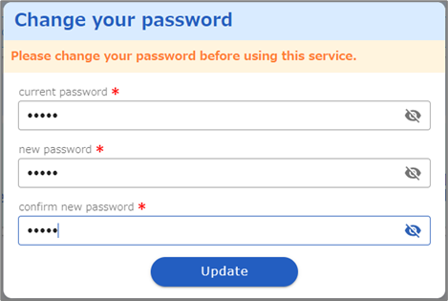
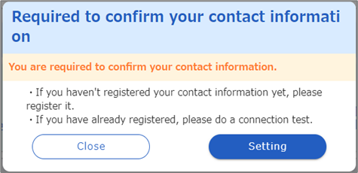
Login
Contacts
Answer
LINE
5. When User menu comes up, you are logged in.
Change your password
If the password change screen appears, change the initial password.
current password:
Enter the current password (initial password).
new password / confirm new password:
Enter the new password twice (up to 16 characters).
Click "Update".
Required to confirm
your contact infoｒmation
If ”Required to confirm your contact information”appears, click “Setting".

Slide 5
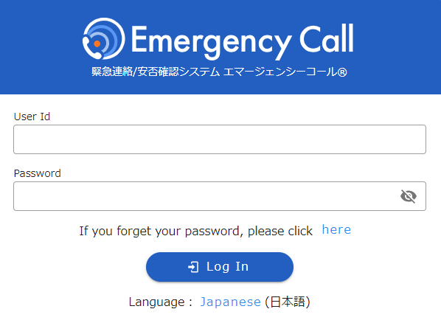
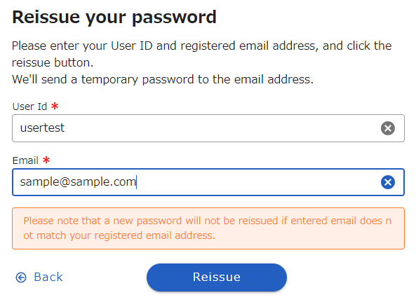
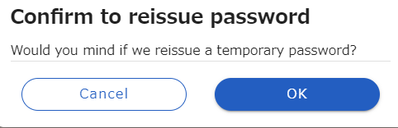
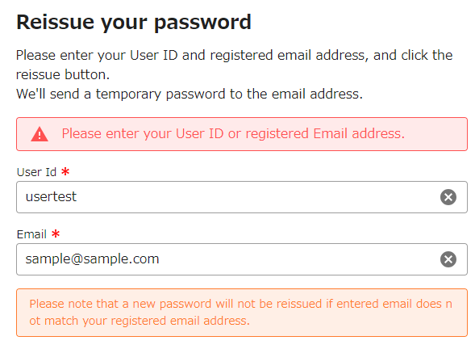
Login
Contacts
Answer
LINE
(２) In Case You Forgot Your Password
When you forgot your password, you can get the system re-issue your password. This is how to do it.
1. Click anywhere on “If you have forgotten
your password, please click here.”
1.
2. Enter User ID and registered mail address,
then click the “Reissue” button.
2.
3. Click “OK” button
3.
This message comes up in red and the
temporary password will be sent to the
entered mail address. "Your temporary
password was re-issued. If you don't
receive temporary password by e-mail,
please re-issue again. “

Slide 6
Login
Contacts
Answer
LINE
2012/12/10 20:07:58
A temporary password has been issued.
Password:XXXXXX
Please login the following URL with this temporary password and set a new password.ＵＲＬ： https://xxxxxxxxx
ＵＲＬ： https://xxxxxxxxx
5. When mail like the left side picture is sent
to the registered address, access the URL
in the body.
5.
6. Enter re-issued User Id and Password,
then click “Login” button.
6.
7. When “Change your password ”
screen comes up, enter the current
password and new one, then click
“Update” button.
7.

Slide 7
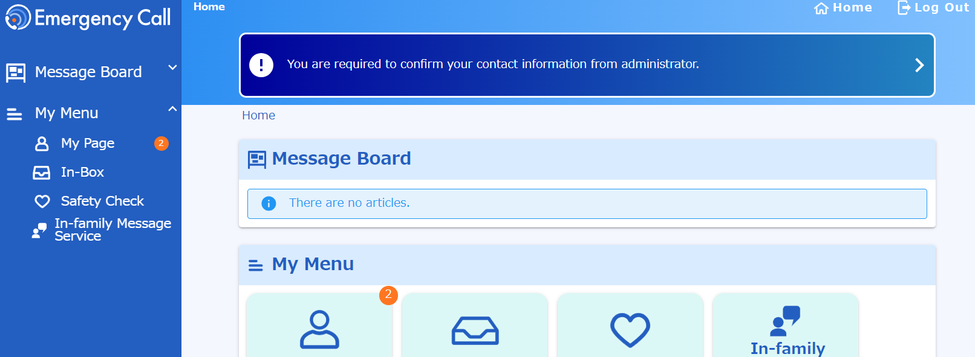
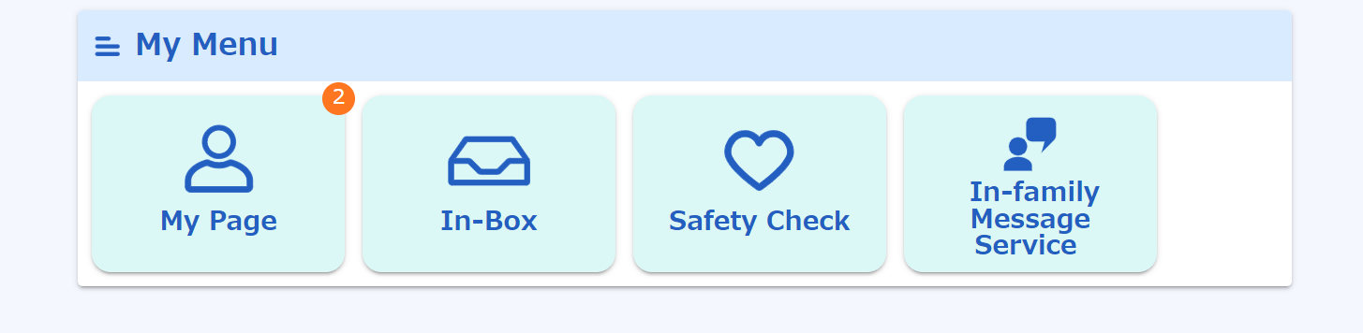
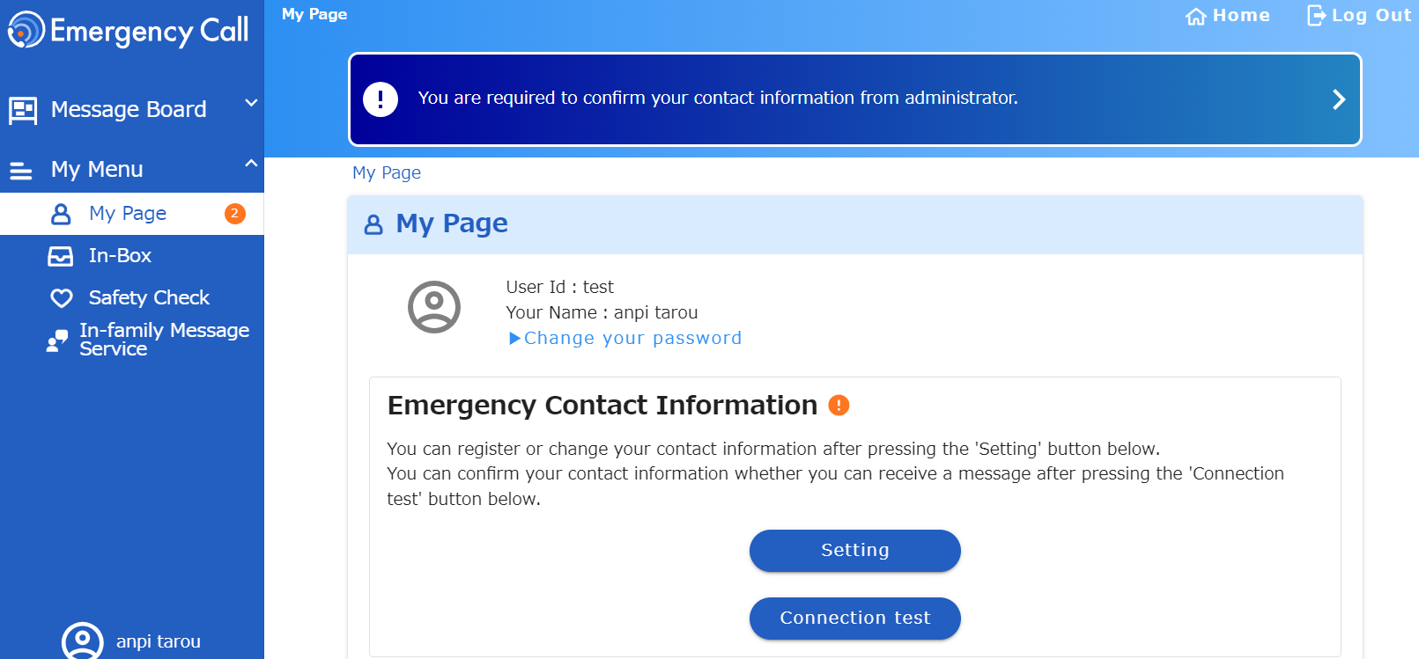
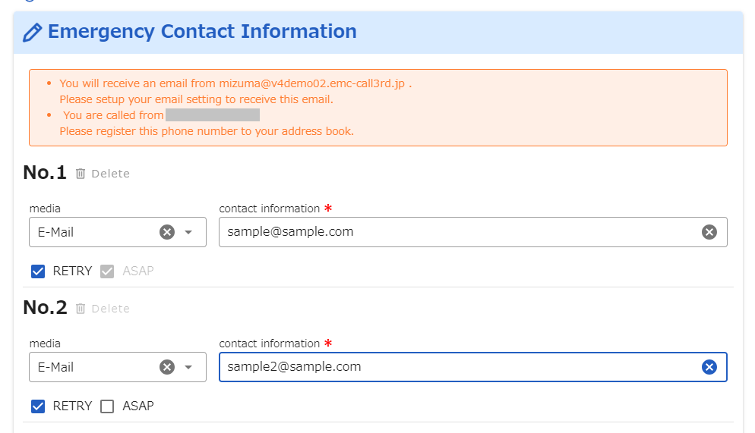
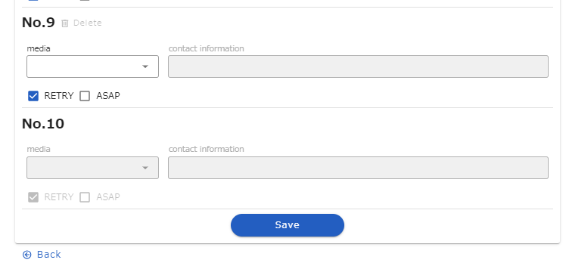
Login
Contacts
Answer
LINE
2. Registering Contacts
(1) Registering Contacts
１. Click on "My Page“ menu.
2. Click on "Setting“ menu.
3. Select the registration medium from the list and enter the contact information.
4.Click the 'Save' button to proceed to the test contact.

Slide 8
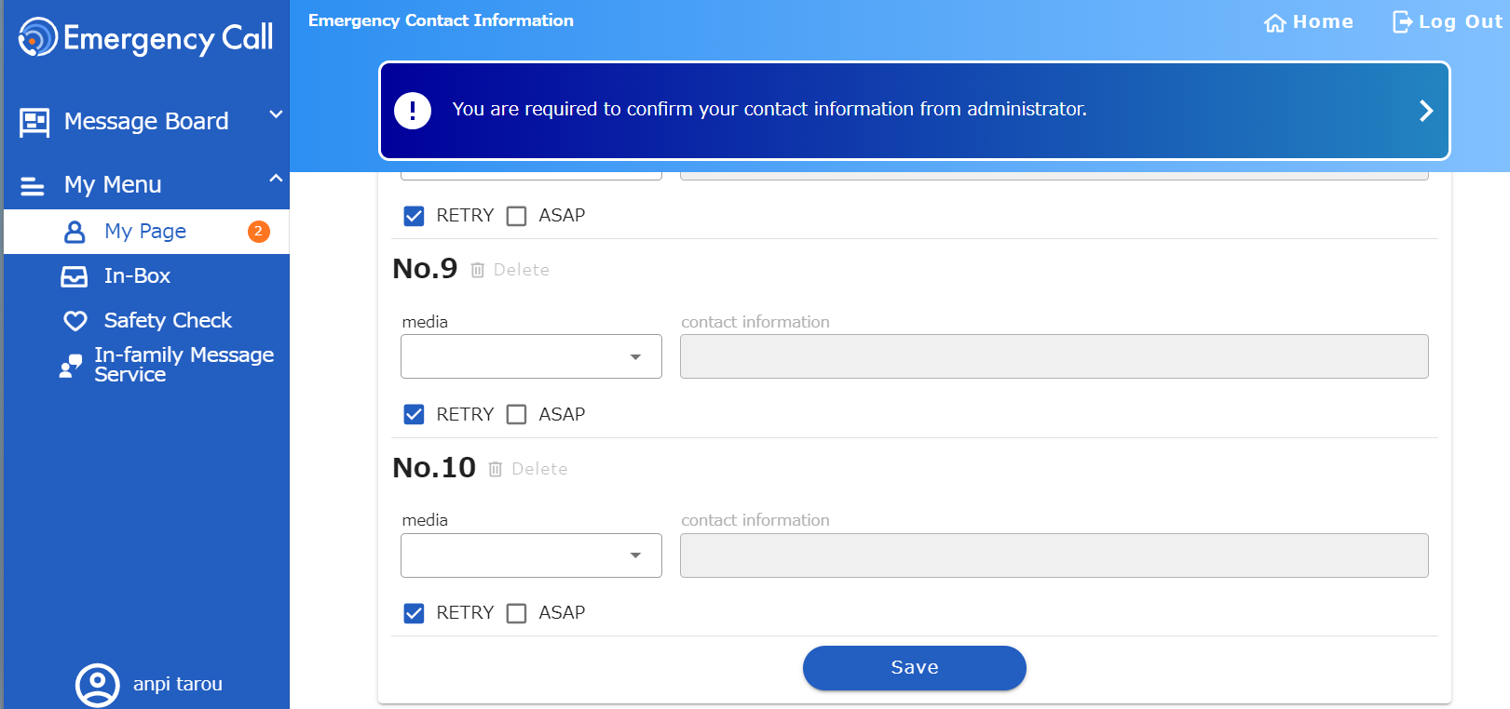
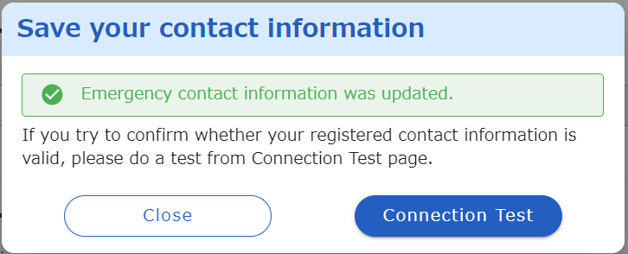
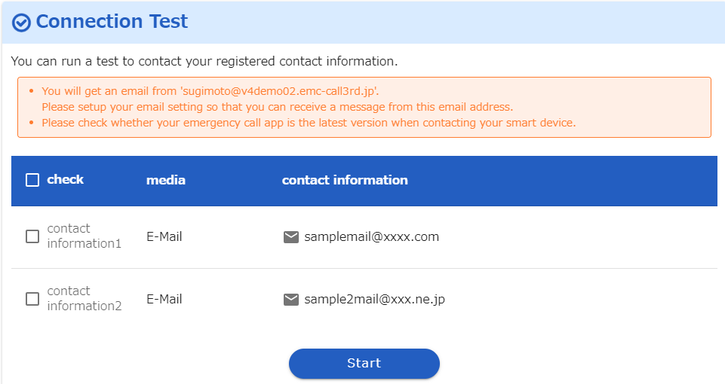
Login
Contacts
Answer
LINE
(1) Registering Contacts
To ensure the registered email addresses are correct and not blocked by spam settings, a test email will be sent from Emergency Call to confirm receipt.
1. Click "Save" on the emergency contact screen.
2. Click “Connection test".
3. Select the contact you want to test, then click "Start".
7
2017/11/21 17:41:45
Emergency contact confirmation test
This is an emergency call sending test. If you do not recognize this email, please delete it.
URL: https://xxxxx
4. If there are no issues with the registered email address, you will receive a test email as shown on the left.
Test contact completed.

Slide 9
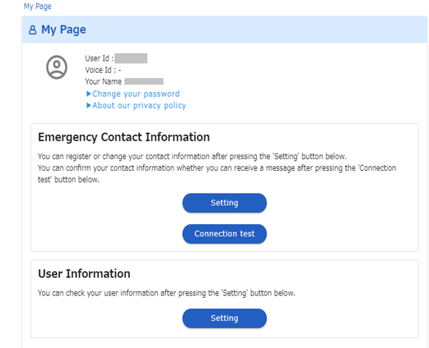
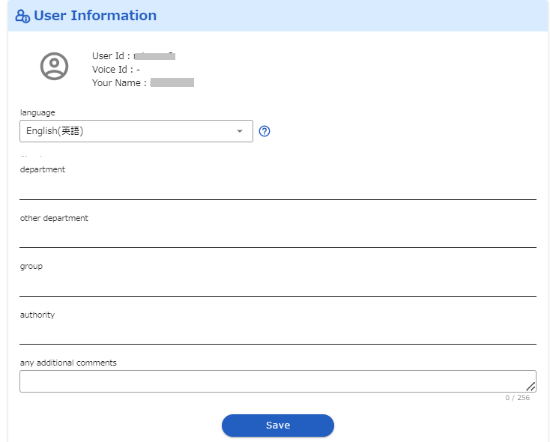
Login
Contacts
Answer
LINE
(3) System Language Selection
The language used in emergency contacts (mail text, web pages) is set by this step.
１. Click on "My Page".
2. Click on "Setting".
3. Change the “Language” value.
Select “English （英語）” from
the dropdown list.
4. Click “Save” button.

Slide 10
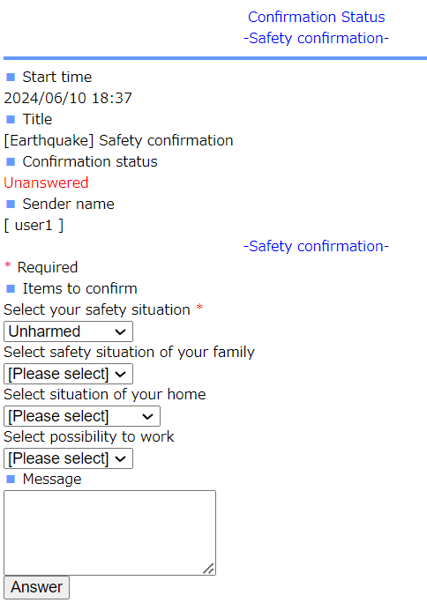

Login
Contacts
Answer
LINE
３. Answer safety status
(1) ) When you get alerts
ユーザ１
2012/12/10 19:41:24
A major earthquake has occurred in the Kanto region. Please register your safety situation.
* Please register your safety situation from the following URL or telephone number.
When the one URL/phone number is unresponsive, please use the other.
If you have no damage, you can reply this E-mail to perform the "register" operation. (ATTENTION! DO NOT USE iPhone MMS.)
ＵＲＬ：https://emc-call.jp/XXXX/
ＵＲＬ：https://emc-call2nd.jp/XXXX/
1. Click the URL in the mail text.
1.
2. Select the answer to each of the
items listed.
3. Click “Answer” or “Confirm” button.
2.
3.

Slide 11
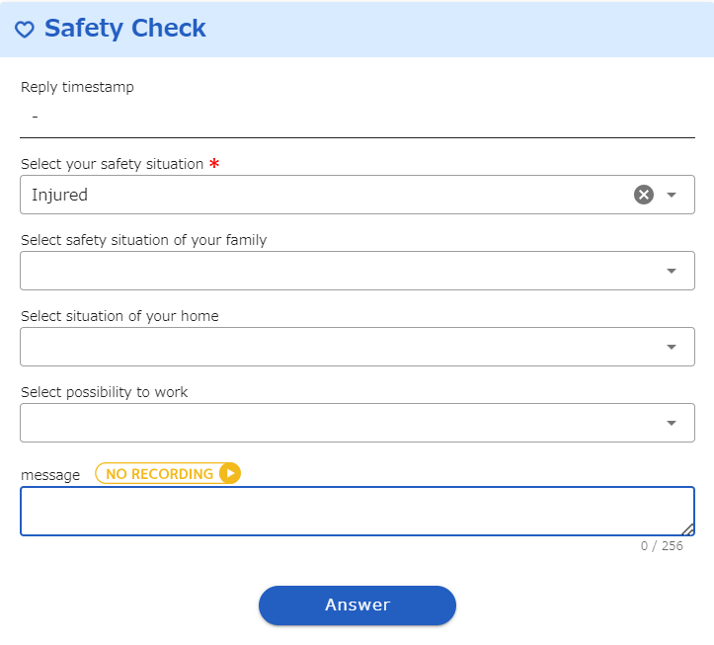
Login
Contacts
Answer
LINE
(2) Answer safety status without received alerts
1. Click “Safety Check” button.
1.
2. Select the answer to each of the
items listed.
3. Click “Answer” button.
2.
3.

Slide 12
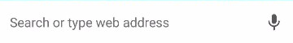
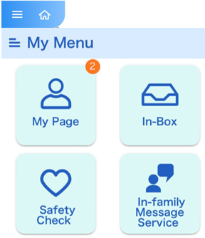
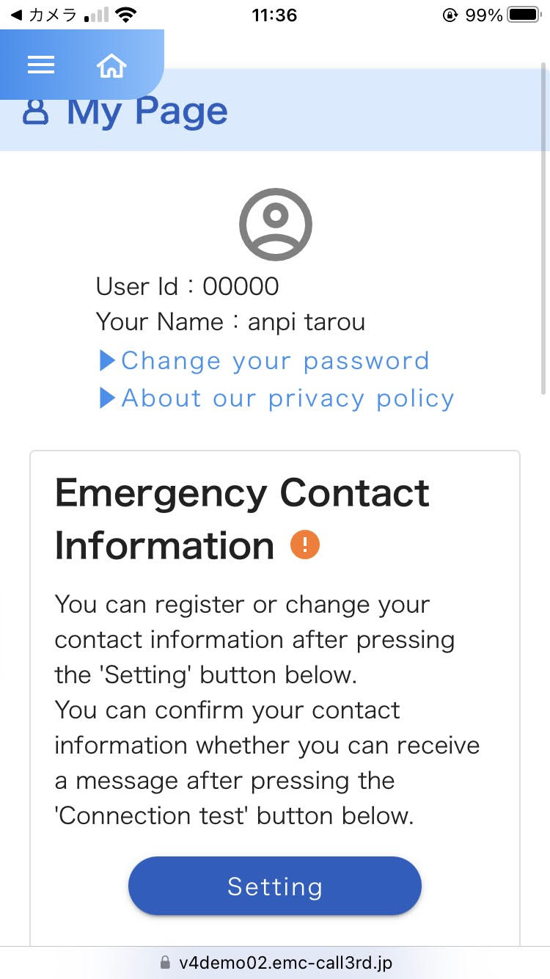
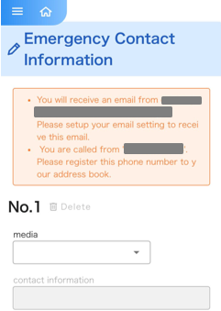
Login
Contacts
Answer
LINE
4. LINE
In Emergency Call, if you use LINE App linkage, emergency contact can be received in LINE account. To use LINE linkage, you need to apply for ”LINE linkage option“.
(1) The LINE App setup
1.
1. For access, enter
"Emergency Call" URL in the address of a browser of a smart device with internet connection.
2.After logging in, tap 'Settings' on the 'My Page' screen.
3. Tap the dropdown menu of the medium where you want to register LINE as a contact.

Slide 13
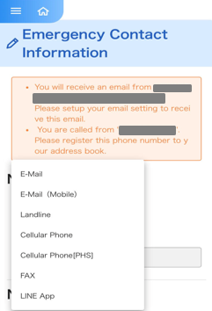
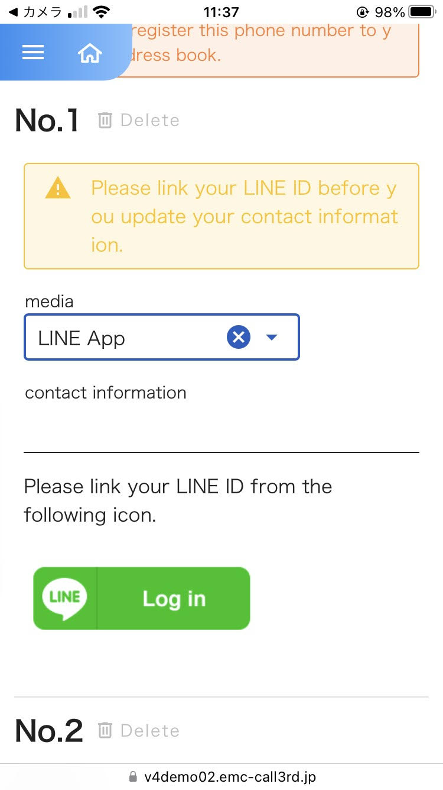
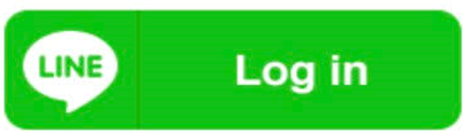
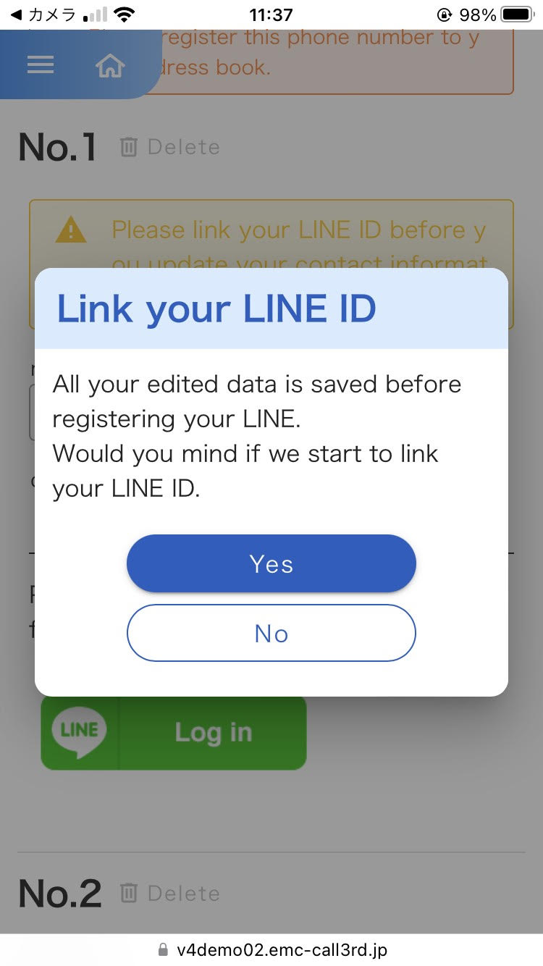
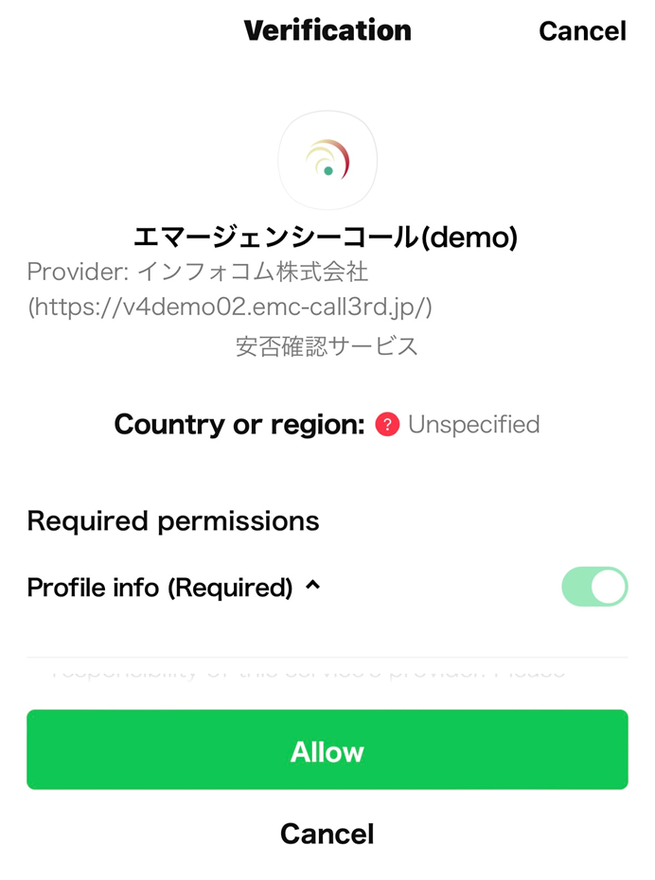
Login
Contacts
Answer
LINE
4. Tap "LINE app" from the list of medium names.
5. Tap
6. Tap 'Yes' on the 'Link your Line ID' confirmation screen.
7. When the LINE authentication screen appears, tap 'Allow'.

Slide 14
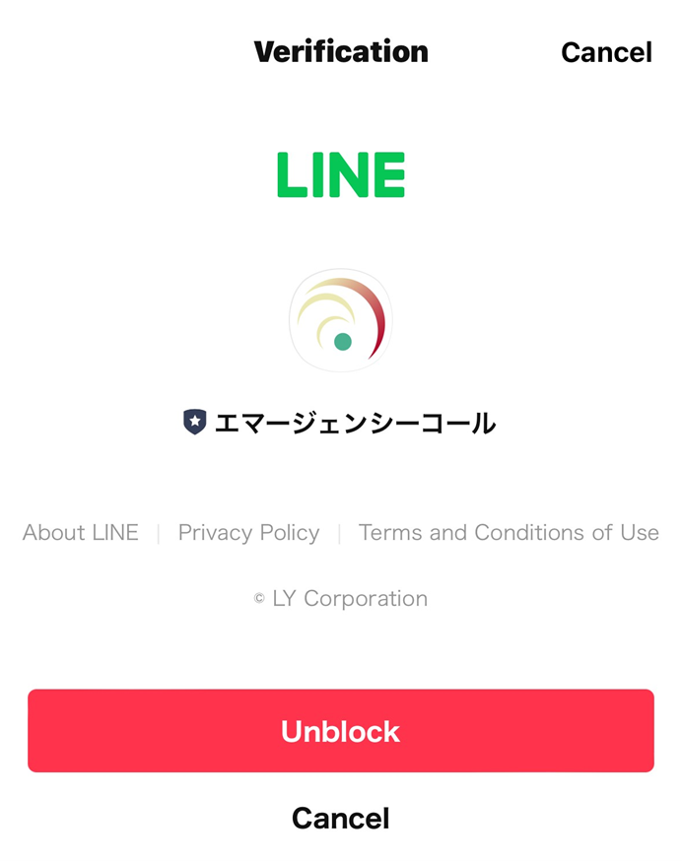
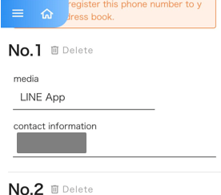
Login
Contacts
Answer
LINE
8.When this screen appears, tap ‘Unblock'.
→ Integration with LINE will be completed.
After linking, if the login screen appears, enter your user ID and password, then log in again.
＜Confirmation of settings＞
Tap 'My Page'.
Tap 'Settings'.
LINE app is registered as a contact.
※ In 'Contacts', names registered in LINE will be displayed.

Slide 15
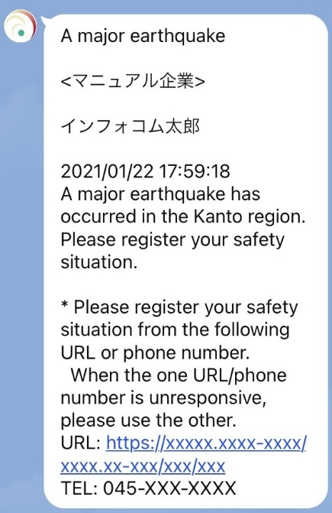
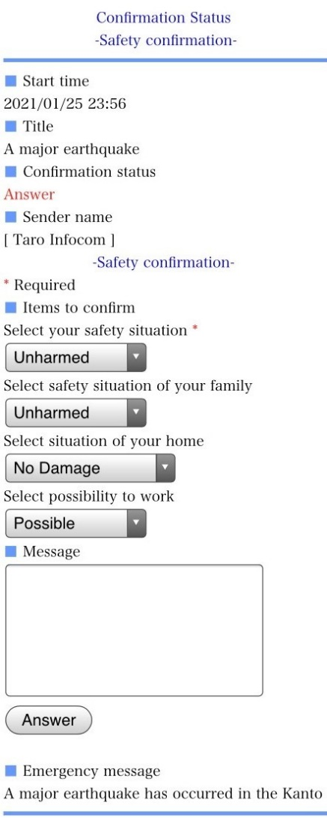
Login
Contacts
Answer
LINE
(2) How to respond using the LINE App
1. In LINE App, you will receive an emergency message, like the picture to the left.
Tap (select) the 「URL」 in the message body.
1.
2. When "URL" is tapped (selected), “Confirmation Status” screen is displayed.
Then tap on the “Answer” or “”Confirm button.
2.

